Slide 1




Sentinel Innovation Day

Slide 2
Agenda
Welcome and Sentinel overview
FDA opening remarks
DI2: Representation of unstructured data across Common Data Models
DI3: Identification and mitigation of structured EHR source data mapping issues
FE1: Computable phenotyping framework
FE2: NLP tools for cohort identification, exposure assessment, covariate ascertainment
FE3: Improving probabilistic phenotyping of incident outcomes
CI1: Enhancing Causal Inference in the Sentinel System
CI2: A causal inference framework for Sentinel
Closing remarks

Slide 3

Overview

Slide 4
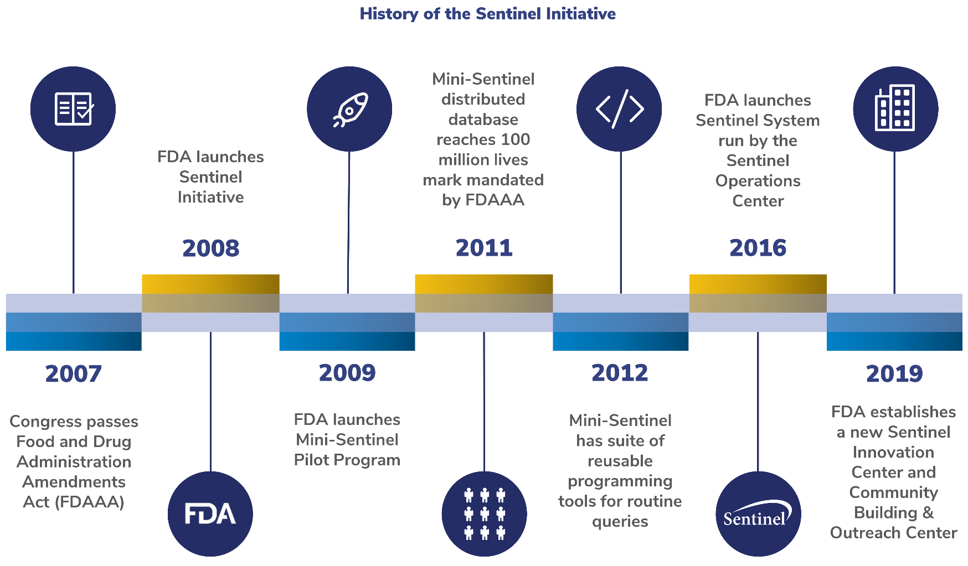
FDA’s Sentinel system
2007 FDA Amendments Act mandates FDA to establish active surveillance system for monitoring drugs using electronic healthcare data
Through the Sentinel Initiative, FDA aims to assess the post-marketing safety of approved medical products

Slide 5
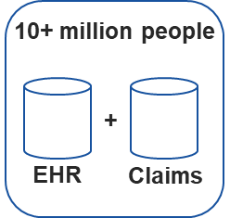
Sentinel Innovation Center (IC) Vision
Current Sentinel system limitations
Sentinel Innovation Center Initiatives
Sentinel Innovation Center vision
Inability to identify certain study populations of interest from insurance claims
Data infrastructure (DI)
Feature engineering (FE)
Emerging methods including machine learning and scalable automated natural language processing (NLP) approaches to enable computable phenotyping from unstructured EHR data
A query-ready, quality-checked distributed data network containing EHR for at least 10 million lives with reusable analysis tools
Inability to identify certain outcomes of interest from insurance claims
Causal inference (CI)
Methodologic research to address specific challenges when using EHRs such as approaches to handle missing data, calibration methods for enhanced confounding adjustment
Detection analytics (DA)
Development of signal detection approaches to account for and leverage differences in data content and structure of EHRs
Other limitations
(inadequate duration of follow-up, the need for additional signal identification tools)
2020
2024
Desai et al. npj Digital Medicine (2021) 4:170
Notes:
The key objective of the Innovation center in close collaboration with the operations center is to expand FDA’s capabilities for Active Risk Identification and Analysis (ARIA)

Slide 6
IC Master Plan:
A snapshot of ongoing and future activities
Priorities | Year 1 | Year 2 | Year 3 | Year 4 | Year 5
 | Master plan | Master plan refinement
Data infrastructure
Identification and queries of potential EHR data partners (Horizon Scan: DI1)
Onboarding EHR data partners
Adding unstructured data and necessary data elements (DI2)
Updating CDM to include EHR data
Source data mapping (DI3)
Data quality metrics and quality assurance strategy
Data governance process
Harmonizing EHRs (DI4)
Data harmonization strategy
FHIR preparedness (DI7)
Death index (DI5)
Feature engineering
Computable phenotyping framework (FE1)
Increasing automation in computable phenotyping
Enhancing transportability of phenotypes
NLP tools for cohort identification, exposure assessment, covariate ascertainment (Scalable NLP: FE2)
NLP tool prototyping and expansion
Improving probabilistic phenotyping of incident outcomes (FE3)
Expanding phenotyping for incident outcomes
Developing NLP-assisted chart abstraction tool (FE4)
Implementing NLP-assisted chart abstraction tool
Causal inference
Evaluating targeted learning in EHR data (Enhancing CI: CI1)
Targeted learning tool development
Performance metrics (CI5)
Causal inference framework (CI2)
Calibration methods (CI4)
Approaches for missing data (CI3)
Distributed regression implementation (CI6)
Detection analytics
Identification and evaluation of EHR detection approaches (DA1)
Empirical evaluation of EHR-based detection approaches (DA2)
Development of EHR-based detection tools
Developing and advancing EHR-based detection methods (DA3)
Methods framework for EHR-based signal detection
Methods for signal detection for pregnancy/birth outcomes (DA4)
Pregnancy and birth outcomes signal detection tool development
Methods for cancer signal detection (DA5)
Cancer signal detection tool development
Innovation incubator
Data Sandbox Discovery Phase
Data Sandbox Implementation Phase

Slide 7
DI2: Representation of unstructured data across Common Data Models
DI3: Identification and mitigation of structured EHR source data mapping issues
Priorities | Year 1 | Year 2 | Year 3 | Year 4 | Year 5
 | Master plan | Master plan refinement
Data infrastructure
Identification and queries of potential EHR data partners (Horizon Scan: DI1)
Onboarding EHR data partners
Adding unstructured data and necessary data elements (DI2)
Updating CDM to include EHR data
Source data mapping (DI3)
Data quality metrics and quality assurance strategy
Data governance process
Harmonizing EHRs (DI4)
Data harmonization strategy
FHIR preparedness (DI7)
Death index (DI5)
Feature engineering
Computable phenotyping framework (FE1)
Increasing automation in computable phenotyping
Enhancing transportability of phenotypes
NLP tools for cohort identification, exposure assessment, covariate ascertainment (Scalable NLP: FE2)
NLP tool prototyping and expansion
Improving probabilistic phenotyping of incident outcomes (FE3)
Expanding phenotyping for incident outcomes
Developing NLP-assisted chart abstraction tool (FE4)
Implementing NLP-assisted chart abstraction tool
Causal inference
Evaluating targeted learning in EHR data (Enhancing CI: CI1)
Targeted learning tool development
Performance metrics (CI5)
Causal inference framework (CI2)
Calibration methods (CI4)
Approaches for missing data (CI3)
Distributed regression implementation (CI6)
Detection analytics
Identification and evaluation of EHR detection approaches (DA1)
Empirical evaluation of EHR-based detection approaches (DA2)
Development of EHR-based detection tools
Developing and advancing EHR-based detection methods (DA3)
Methods framework for EHR-based signal detection
Methods for signal detection for pregnancy/birth outcomes (DA4)
Pregnancy and birth outcomes signal detection tool development
Methods for cancer signal detection (DA5)
Cancer signal detection tool development
Innovation incubator
Data Sandbox Discovery Phase
Data Sandbox Implementation Phase

Slide 8
Challenges and Opportunities in Integrating Electronic Health Record (EHR) Data in Sentinel
Keith Marsolo, PhD
Associate Professor
Department of Population Health Sciences
Duke Clinical Research Institute
Duke University School of Medicine
4/28/22

Slide 9
Purpose

Slide 10
IC Projects -- Highlight Challenges and Opportunities
As the Sentinel Innovation Center works to establish an infrastructure of administrative claims linked with electronic health record (EHR) data on 10 million+ lives:
Focus = two projects that develop aspects of the infrastructure needed to bring EHR data into the Sentinel framework
  Each highlights potential challenges and opportunities presented by EHR
  DI2: Representation of unstructured data across Common Data Models
  DI3: Identification and mitigation of structured EHR source data mapping issues

Slide 11
DI2: Representation of Unstructured Data Across Common Data Models

Slide 12
Incorporating Unstructured Data into a Common Data Model
Goal: To guide the Sentinel Network on how best to incorporate information derived from unstructured data into a Common Data Model (CDM) framework.
Objectives:
What information is important? – Identify the priority elements that should be derived from unstructured data
What NLP tools are in use & how are they used?; What information is available within a note? – Assess the overall availability of the priority elements within the Sentinel ecosystem
How to best represent information derived from unstructured text? – Recommend how those priority elements should be represented in the Sentinel Common Data Model
Project completion date: May 31, 2022 (to be extended)

Slide 13
Project team
HPHCI
Judy Maro,
Co-Investigator
Kathleen Shattuck, Project Manager
Duke
Keith Marsolo, PI
Lesley Curtis,
Co-Investigator
Chuan Hong,
Co-Investigator
Ruth Reeves,
Co-Investigator
Sarah Palmer, Project Leader/ Analyst
Vanderbilt
Dax Westerman, Principal Application Developer
Juan Zhao, Co-Investigator
BWH
Li Zhou,
Co-Investigator
Jaiden Dumas, Clinical Research Coordinator
Ziyang He, Student
Suzanne Blackley, Applications Analyst
John Laurentiev, Applications Analyst
FDA
Sarah Dutcher
Efe Eworuke
Aida Kuzucan
Jill Whitaker, Data Analyst
Tina French, Data Analyst
Liz Hanchrow, Senior Application Analyst
R
Tyler Erikson, Statistician, Statistician
Subject Matter Experts
Joseph Plasek (BWH); others TBD

Slide 14
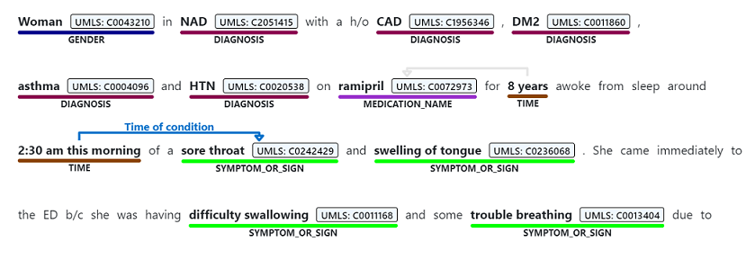
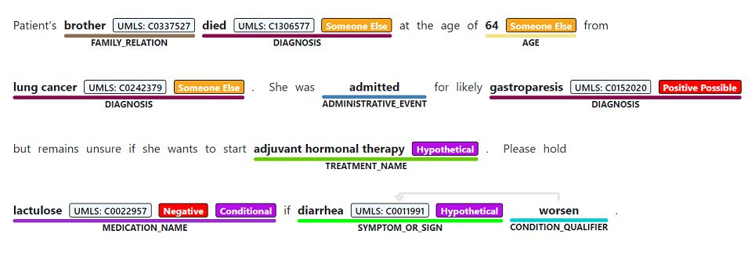
Objective 1 – What information is important?
Process:
Generated list of concepts from commonly-used NLP pipelines (commercial & open-source)
  Focused mainly on broad categories, not specific items, unless called out in documentation (e.g., medications, not aspirin)
  Looked at the basic functionality provided by each tool, not every research project
  Generated “good enough” list – stopped when we reached saturation
FDA reviewed list, identified any missing elements & assigned priority rankings (high / medium / low) - highest priority given to those concepts not easily obtained from claims that are also important for drug safety studies
End Product:
Set of priority elements to be derived from unstructured text.
Image source: https://docs.microsoft.com/en-us/azure/cognitive-services/text-analytics/how-tos/text-analytics-for-health

Slide 15
Example priority rankings (subset)
Domain | Concept(s) | Priority | Notes
Cancer | Site | High | Several ARIA insufficiency rankings due to lack of data on cancer (e.g., staging)
 | Histology | High
 | Procedure | High
Condition | Diagnoses | Medium | Often captured in claims
 | Signs / Symptoms | High | Less available in claims, useful in different aspects of studies
 | Family History (Type) | Medium | Useful in some studies, but not all
 | Medical History (Type) | High | Often gaps in EHR data, medical history important to capture
Medication | Class | Low | Can be inferred from drug name
Concepts
from
existing
tools
Concept(s) | Priority | Notes
Timing & duration of medication | High | Particularly important for inpatient medications
Physical findings (e.g., vital signs) | High | Key covariate for FDA studies, under-captured in claims
Indication for a drug | High | Rationale for why a drug is given
Oxygen support | High | Relevant for many COVID-19 studies
Death (date) & cause | Low* | Capture of death data varies by Sentinel Data Partner
Missing
concepts

Slide 16
Objective 2 – What NLP tools are in use and how are they used? What information is available within a note?
Process:
Distributed survey to partners within the Sentinel ecosystem to assess their NLP capabilities (e.g., tool(s) used, notes processed, concepts extracted, etc.) – understand how well the current state of NLP use aligns with the priority concepts identified by FDA
Perform chart annotations at 2 sites (Vanderbilt, Brigham & Women’s Hospital) to assess availability of priority elements within 2 different use cases (in progress)
End Product:
Survey responses from Partners on their ability to extract priority data elements from unstructured text, and statistics on the overall availability of priority data elements within the unstructured data as determined by chart annotation.

Slide 17
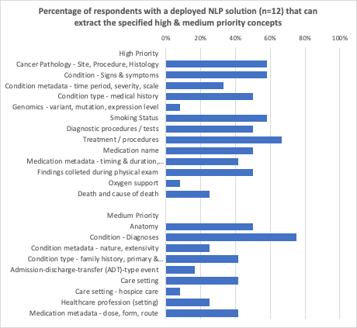
NLP capabilities survey (initial results)
Distributed to 14 Sentinel Data Partners & 8 partners affiliated with the Innovation Center
A total of 17 responses received (13 from Sentinel Data Partners)
  12 use NLP in some capacity
  50% for project-specific research; 50% for research & “operational” purposes
Wide variety of tools used / notes processed (type, number of years)
Scope of concepts extracted also varies widely
  9 of 12 report being able to extract Diagnoses (highest percentage)
  Handful of other concepts extracted by >50% of respondents (e.g., cancer site & histology, smoking status, signs & symptoms)

Slide 18
Chart annotation - Motivation
Vision
A future state where Sentinel partners with access to EHR data have processed all / some of their clinical notes through an NLP pipeline (or pipelines).
  Some projects may require the development of new pipelines/classifiers,
  Others will rely on the “stock” NLP outputs.
We want to use those derived data elements in a Sentinel analysis.
Issues to consider:
  What note type(s) need to have been processed?
  What time frame had to have been covered?
Example
Looking for history of MI:
  patient had MI 10 years ago
  Can we assume it is mentioned in the note at every visit, or just a subset (i.e., first visit with a new provider; every visit for the 2 years after the event, etc.)?

Slide 19
Chart annotation (in progress)
Focus on two use cases
  Hospitalized patients with COVID-19
  Cancer
For both, we propose to look at a subset of notes, since we will not necessarily be able to assume that (future) partners will have run NLP on everything (e.g., all hospital discharge summaries are included, but not respiratory therapist notes)
Purpose is not to develop a classifier or a pipeline, but to describe the information contained in the notes of the patients in each cohort

Slide 20
Hospitalized patients with COVID-19
Population:
  Index event - inpatient encounter with an admitting diagnosis of COVID-19 between April 1, 2020 and December 31, 2021
  Limit to patients who are age >= 18 at the time of admission.
Sampling strategy:
  Cohort 1 – patients without a billing code for supplemental oxygen. Select 35 patients at random.
  Cohort 2 – patients with a billing code for supplemental oxygen. Select 35 patients at random.
Analysis:
  Primary – Pull the discharge summary associated with the hospitalization and annotate priority concepts (e.g., oxygen use, conditions, medication exposure & metadata, smoking status)
  Secondary – For a subset of patients in each cohort (5-10, randomly selected), run a query to identify all notes that include keywords related to oxygen use. Review note / paragraph / sentences around the keyword and determine whether it indicates oxygen use.
Rationale for design choices:
  The secondary analysis will allow us to characterize the degree of “missingness” related to oxygen use, as discharge summaries are not expected to contain the full detail related to oxygen use
  Discharge summaries were chosen because if we are planning to use pre-computed NLP concepts in an analysis, discharge summaries are more likely to be processed across a network than specialty notes (e.g., respiratory therapy)
  Stratifying by billing codes for supplemental oxygen should ensure there is a mix of patients who did and did not receive oxygen compared with a purely random sample of hospitalized patients

Slide 21
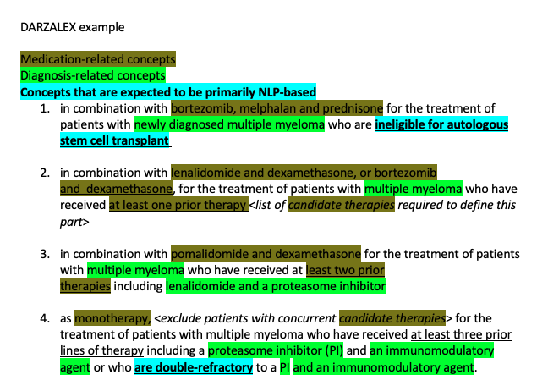
Cancer
Population:
Index event
Patients with a prescription/order for darzalex (daratumumab) and with no prescription/order for darzalex in the prior 3 years.
Index event should be between January 1, 2016 and November 30, 2021.
Sampling strategy:
Select 30 patients at random from the cohort
Annotate the physician note(s) associated with the visit where the patient was prescribed the medication (assume new prescription occurs in the outpatient setting)
Analysis:
Annotate selected concepts (e.g., conditions, medications, smoking status, those specific to label);
Determine if available concepts are sufficient to determine indication behind prescription

Slide 22
Objective 3 – How to best represent information derived from unstructured text? (in progress)
Process:
Assess current approaches for representing data derived from unstructured text (from other Common Data Models, NLP tools, etc.)
Describe tradeoffs between approaches (e.g., ease of querying, burden on partners, strengthens and weaknesses of different terminologies)
End Product:
Develop set of recommendations for the Sentinel Operations Center as they make decisions on extending the Sentinel Common Data Model

Slide 23
DI3: Identification and mitigation of structured EHR source data mapping issues

Slide 24
Mapping of EHR Data and developing quality metrics
Goal:
To assess the mapping of structured electronic health record (EHR) data to reference terminologies and to develop quality metrics to allow for comparisons across domains within a data source to further identify issues.
Objectives:
Develop procedures to assess the mapping of structured EHR data to reference terminologies for laboratory results, medication orders and administrations (inpatient and outpatient) & characterize the severity of issues that are uncovered
Develop standardized metrics related to medications & laboratory results that allow for comparisons across domains within a data source using profiles of records across time, care setting, population, etc. This work will supplement the Sentinel Operations Center’s Data Quality Measures (DQM) in EHRs project by defining new metrics for assessments that are not routinely conducted in EHR datasets.
Project completion date: September 30, 2022

Slide 25
Project team
HPHCI
Judy Maro,
Co-Investigator
Kevin Coughlin, Project Manager
Duke
Keith Marsolo, PI
Lesley Curtis,
Co-Investigator
Gretchen Sanders, Project Lead
Alanna Chamberlain,
Co-Investigator (Mayo Clinic)
Laura Qualls
Jennifer Xu,
Informaticists
PCORnet Sites
Yinghong Zhang
Tom Phillips,
Programmers
Larry Hill, Statistician
FDA
Sarah Dutcher
Monique Falconer
Jose Hernandez
Dan Kiernan, Data Analytics
Jiang Bian
Co-Investigator
(U of Florida)

Slide 26
Motivation – Harmonization of EHR data sources
Many EHR data domains (e.g., medication orders, laboratory results) are not captured in standard formats
To use these data for research or for data exchange, must harmonize to a reference standard
Examples shown within these slides are taken from the National Patient-Centered Clinical Research Network (PCORnet®), but the same challenges exist regardless of the source
For analyses that leverage linked claims-EHR data, findings from this project can provide guidance on the types of EHR data to be included in a CDM and how to ensure and verify accurate transformation

Slide 27
Representing a medication in RxNorm
 | RxNorm Term Type | Information encoded |  |  |  | Example medication representation
 | Description | Ingredient(s) | Strength | Dose Form | Brand Name | Original string - Augmentin XR 12 HR 1000 MG Extended Oral Release Tablet
Most Granular | Semantic Branded Drug | X | X | X | X | Augmentin XR 12 HR 1000 MG Extended Release Oral Tablet
 | Semantic Clinical Drug | X | X | X |  | 12 HR Amoxicillin 1000 MG / Clavulanate 62.5 MG Extended Release Oral Tablet
 | Brand Name Pack | X | X | X | X | N/A
 | Generic Pack | X | X | X |  | N/A
 | Semantic Branded Drug Form | X |  | X | X | Amoxicillin / Clavulanate Extended Release Oral Tablet [Augmentin]
 | Semantic Clinical Drug Form | X |  | X |  | Amoxicillin / Clavulanate Extended Release Oral Tablet
↓ | Semantic Branded Dose Form Group* |  |  | X | X | Augmentin Oral Product; Augmentin Pill (Requires two records)
 | Semantic Clinical Dose Form Group* | X |  | X |  | Amoxicillin / Clavulanate Oral Product; Amoxicillin / Clavulanate Pill (Requires two records)
 | Semantic Branded Drug Component | X | X |  | X | Amoxicillin 1000 MG / Clavulanate 62.5 MG [Augmentin]
 | Brand Name |  |  |  | X | Augmentin
 | Multiple Ingredients | X |  |  |  | Amoxicillin / Clavulanate
 | Semantic Clinical Drug Component* | X | X |  |  | Amoxicillin 1000 MG; Clavulanate 62.5 MG (Requires two records)
 | Precise Ingredient | X |  |  |  | N/A
Least Granular | Ingredient* | X |  |  |  | Amoxicillin; Clavulanate (Requires two records)
Non-specific | Dose Form |  |  | X |  | Extended Release Oral Tablet
 | Dose Form Group* |  |  | X |  | Oral Product; Pill (Requires two records)
 | Prescribable Name
 | Synonym
 | Tall Man Lettering Synonym
Within the PCORnet Common Data Model, medication orders and administrations (at most sites) are coded using RxNorm
RxNorm is an interoperability standard maintained by the National Library of Medicine that represents medication orders and administrations at various levels of granularity
Even if Sentinel leverages a different standard to represent EHR-based medications, data partners may still need to transform data to/from RxNorm
* Denotes term types that require multiple records to represent multi-ingredient medications

Slide 28
PCORnet has defined a set of preferred “tiers” for the different RxNorm Term Types
 |  | RxNorm Term Type | Information encoded
 | Term Type | Description | Ingredient(s) | Strength | Dose Form | Brand Name
Tier 1 | SBD | Semantic Branded Drug | X | X | X | X
 | SCD | Semantic Clinical Drug | X | X | X
 | BPCK | Brand Name Pack | X | X | X | X
 | GPCK | Generic Pack | X | X | X
Tier 2 | SBDF | Semantic Branded Drug Form | X |  | X | X
 | SCDF | Semantic Clinical Drug Form | X |  | X
↓ | SBDG | Semantic Branded Dose Form Group* |  |  | X | X
 | SCDG | Semantic Clinical Dose Form Group* | X |  | X
 | SBDC | Semantic Branded Drug Component | X | X |  | X
 | BN | Brand Name |  |  |  | X
 | MIN | Multiple Ingredients | X
Tier 3 | SCDC | Semantic Clinical Drug Component* | X | X
 | PIN | Precise Ingredient | X
 | IN | Ingredient* | X
Tier 4 (Do not use) | DF | Dose Form |  |  | X
 | DFG | Dose Form Group* |  |  | X
 | PSN | Prescribable Name
 | SY | Synonym
 | TMSY | Tall Man Lettering Synonym
* Denotes term types that require multiple records to represent multi-ingredient medications

Slide 29
Example quality issue – medication mapping
Highest-volume medication records by RxNorm code |  |  |  | Highest-volume medication records by name (within the EHR) |  |  | Percent Agreement
Rank based on Code | RxNorm Code | Medication name (derived from RxNorm code) | Record Count by Code | Rank based on Name | Medication name (from EHR) | Record Count by Name
1 | Null or missing |  | 1257171 | 1 | Null or missing | 1257171 | 100%
2 | 313002 | Sodium Chloride 9 MG/ML Injectable Solution | 801348 | 2 | Sodium Chloride | 1007029 | 79.6%
3 | 307668 | Acetaminophen 32 MG/ML Oral Suspension | 321510 | 3 | Acetaminophen 300MG / Codeine Phosphate 15 MG Oral Tablet | 511779
4 | 197803 | Ibuprofen 20 MG/ML Oral Suspension | 293209 | 4 | Ibuprofen 20 MG/ML / Pseudoephedrine Hydrochloride 3 MG/ML Oral Suspension | 293218
5 | 540930 | Water 1000 MG/ML Injectable Solution | 286133 | 5 | Water 1000 MG/ML Injectable Solution | 287011 | 99.6%
6 | 309778 | Glucose 50 MG/ML Injectable Solution | 285557 | 6 | Glucose 50 MG/ML / Potassium Chloride 0.01 MEQ/ML / Sodium Chloride 0.0342 MEQ/ML Injectable Solution | 286108 | 99.8%
Shading indicates a discordance in medications (e.g., RxNorm code represents a single ingredient in RxNorm vs. multi-ingredient order within the EHR)

Slide 30
Objective 1: Methods to assess mapping of structured EHR data to reference terminologies
General approach:
Develop queries to assess mapping of medication orders, medication administrations and laboratory tests – limit analysis to the top 200 by volume
For each medication / lab, generate statistics on all the different combinations within the structured fields and “raw” source fields
For example, for a given medication name, summarize the number of records/patients for associated RxNorm codes, dose units, dose forms, as well as the corresponding ”raw” fields
RAW Medication Name | RxNorm Code | CDM Dose Unit | RAW Dose Unit | Number of Records | Number of Patients
CALCIUM CARBONATE 300 MG (750 MG) CHEWABLE TABLET | 1044532 | Other |  | 2 | 2
 | 1044532 | Other | mg of elemental | 13 | 11
 | 1044532 | Other | mg of salt | 50564 | 14817
 | 1044532 | Other | tablet | 1 | 1
 | 1484737 | Other |  | 3 | 2
 | 1484737 | Other | mg of elemental | 4 | 3
 | 1484737 | Other | mg of salt | 51092 | 14887
 | 1484737 | Other | tablet | 2 | 2
Example statistics for Dose Unit for a single medication
Notes:
Reference terminologies: laboratory results, medication orders and administrations (inpatient and outpatient)
Hypothesis: critical issues will be identified and that applying these techniques to datasets prior to analysis will improve data quality.
For any critical issues identified, we will ask sites to do a manual review of their source system(s) and / or CDM pipelines to determine if the issues truly exist and if there is an underlying cause.

Slide 31
Objective 1: Evaluation
Generate statistics on number of medication codes/ laboratory tests associated with more than one name within the EHR and vice versa
Concordance between lab name / medication name (brand and/or ingredient) within the EHR and that derived from the associated code
Concordance between discrete fields (e.g., lab result unit, medication dose, etc.) and those associated with the associated LOINC / RxNorm code
Generate characterization of issues by severity (e.g., LOINC code mis-match, combination medication represented by single-ingredient RxNorm code, generic medication represented by brand name, etc.)
End product:
Procedures that can be used to assess mapping of structured EHR domains and a set of statistics on the severity of issues at 2 pilot sites (PCORnet).

Slide 32
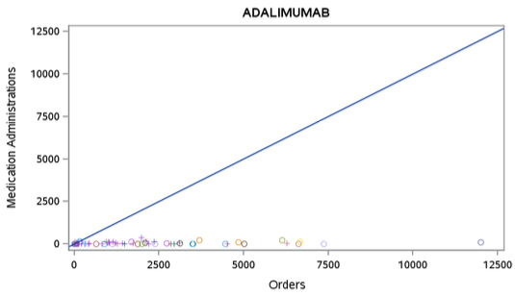
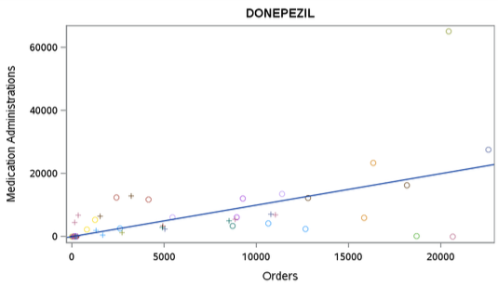
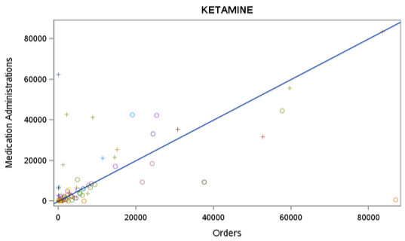
Example quality issue – differences based on provenance (orders vs. medication administrations)
Indicates potential outlier

Slide 33
Objective 2: Standardized metrics to generate comparisons based on provenance
COHORT | PERIOD | CONCEPT | PROVENANCE | NUMBER OF PATIENTS | NUMBER OF RECORDS
COPD | 2016 | CAD DX | ORDERED
COPD | 2016 | CAD DX | BILLED
COPD | 2016 | CAD DX | DERIVED (e.g., NLP)
COPD | 2017 | CAD DX | ORDERED
COPD | 2017 | CAD DX | BILLED
COPD | 2017 | CAD DX | DERIVED (e.g., NLP)
ALL | 2016 | CAD DX | ORDERED
ALL | 2016 | CAD DX | BILLED
ALL | 2016 | CAD DX | DERIVED (e.g., NLP)
ALL | 2017 | CAD DX | ORDERED
ALL | 2017 | CAD DX | BILLED
ALL | 2017 | CAD DX | DERIVED (e.g., NLP)
General approach:
Develop queries that will support the comparison of records based on provenance – medication orders vs. administrations; billed diagnoses vs. clinician-entered – to identify potential data issues.
Define specific conditions & associated concepts to investigate (e.g., diagnoses, procedures, medications, labs). Look at values within each cohort as well as the population as a whole.
Distribute query package to partner sites to generate summary statistics. Focus of analysis will be within-DataMart comparisons, though cross-DataMart comparisons are also possible.
End product:
Set queries to support cross-domain comparisons within a dataset, at both condition and population-level, along with statistics describing the performance of each at partners sites.
Diagnoses by provenance for a specific cohort (COPD) and the population as a whole.
COHORT | PERIOD | MEDICATION | ENCOUNTER TYPE | PROVENANCE | NUMBER OF PATIENTS
CKD | 2016 | LOOP DIURETIC | AMBULATORY | PRESCRIBING
CKD | 2016 | LOOP DIURETIC | AMBULATORY | MED_ADMIN
CKD | 2016 | LOOP DIURETIC | AMBULATORY | BOTH
CKD | 2016 | LOOP DIURETIC | INPATIENT | PRESCRIBING
CKD | 2016 | LOOP DIURETIC | INPATIENT | MED_ADMIN
CKD | 2016 | LOOP DIURETIC | INPATIENT | BOTH
ALL | 2016 | LOOP DIURETIC | AMBULATORY | PRESCRIBING
ALL | 2016 | LOOP DIURETIC | AMBULATORY | MED_ADMIN
ALL | 2016 | LOOP DIURETIC | AMBULATORY | BOTH
ALL | 2016 | LOOP DIURETIC | INPATIENT | PRESCRIBING
ALL | 2016 | LOOP DIURETIC | INPATIENT | MED_ADMIN
ALL | 2016 | LOOP DIURETIC | INPATIENT | BOTH
Number of patients with a medication by provenance and encounter type for a specific cohort (CKD) and the population as a whole.
Notes:
Hypothesis: condition-specific profiles will identify more outliers than population-level summaries
Next steps: small number of sites in this initial pilot, thus, a broader cross-dataset analysis will need to occur as part of another project (DQM in EHR) or future project.

Slide 34
Questions?

Slide 35
FE1: Computable phenotyping framework
FE2: NLP tools for cohort identification, exposure assessment, covariate ascertainment
FE3: Improving probabilistic phenotyping of incident outcomes
Priorities | Year 1 | Year 2 | Year 3 | Year 4 | Year 5
 | Master plan | Master plan refinement
Data infrastructure
Identification and queries of potential EHR data partners (Horizon Scan: DI1)
Onboarding EHR data partners
Adding unstructured data and necessary data elements (DI2)
Updating CDM to include EHR data
Source data mapping (DI3)
Data quality metrics and quality assurance strategy
Data governance process
Harmonizing EHRs (DI4)
Data harmonization strategy
FHIR preparedness (DI7)
Death index (DI5)
Feature engineering
Computable phenotyping framework (FE1)
Increasing automation in computable phenotyping
Enhancing transportability of phenotypes
NLP tools for cohort identification, exposure assessment, covariate ascertainment (Scalable NLP: FE2)
NLP tool prototyping and expansion
Improving probabilistic phenotyping of incident outcomes (FE3)
Expanding phenotyping for incident outcomes
Developing NLP-assisted chart abstraction tool (FE4)
Implementing NLP-assisted chart abstraction tool
Causal inference
Evaluating targeted learning in EHR data (Enhancing CI: CI1)
Targeted learning tool development
Performance metrics (CI5)
Causal inference framework (CI2)
Calibration methods (CI4)
Approaches for missing data (CI3)
Distributed regression implementation (CI6)
Detection analytics
Identification and evaluation of EHR detection approaches (DA1)
Empirical evaluation of EHR-based detection approaches (DA2)
Development of EHR-based detection tools
Developing and advancing EHR-based detection methods (DA3)
Methods framework for EHR-based signal detection
Methods for signal detection for pregnancy/birth outcomes (DA4)
Pregnancy and birth outcomes signal detection tool development
Methods for cancer signal detection (DA5)
Cancer signal detection tool development
Innovation incubator
Data Sandbox Discovery Phase
Data Sandbox Implementation Phase

Slide 36
Health Outcomes and Covariates for Computable Phenotyping Using EHR Data
Lessons Learned from : Advancing scalable natural language processing approaches for unstructured electronic health record data
Workgroup Leads: David S. Carrell, PhD
4/1/22

Slide 37
Outline
Motivation
  Role of computable algorithms in Sentinel
  Limitations of claims data
  The promise of using EHR data and machine learning (ML) methods
Scalable algorithm development
Filters in outcome identification
  Role in outcome identification
  Data-driven, high-sensitivity filtering (HSF)

Slide 38
Motivation: Role of computable algorithms in Sentinel
Allow safety issues to be investigated rapidly, at ~low cost
ARIA = the Active Risk Identification and Analysis system
Analytic Tools
Common Data Model
ARIA
Claims data (no manual chart review required)
Pre-defined, parameterized, re-usable tools
slide courtesy of Michael Nguyen
Notes:
Many of you are already familiar with ARIA, the FDA’s Active Risk Identification and Analysis system designed for post-market safety surveillance.
ARIA has two main features:
A set of pre-defined, parameterized, reusable analytic tools (used to query data and conduct analyses of that data), and
Electronic claims data (and its equivalent extracted from EHRs) structured according to a well-defined common data model (the Sentinel common data model)
These two features allow Sentinel to quickly and easily execute distributed programs across a network incorporating data on more than 100 million lives to perform risk identification analyses.

Slide 39
Motivation: Limitations of structured claims data
Safety Issues
211
Pre-Approval
111
Post-Approval
100
Not Sufficient
88
Not Yet Recorded
22
Sufficient
2
Not Sufficient
21
Not Yet Recorded
54
Sufficient
26
Study Pop
50
Exposure
13
Outcome
66
Covariate
24
Analysis Tool
36
Study Pop
11
Exposure
8
Outcome
10
Covariate
4
Analysis Tool
1
Reliance on existing Sentinel data in ARIA analyses has revealed various insufficiencies
Incorporating rich EHR data may overcome some of these insufficiencies.
This slide courtesy of Michael Nguyen
Notes:
There are, however, several reasons why ARIA may not be sufficient.
An FDA-led evaluation of 211 safety issues found several reasons for ARIA insufficiency, but the most common challenge, appearing in 70% of studies where ARIA was not sufficient [(66+10) / (88+21)] was the inability to accurately capture the outcome (the “health outcome of interest”) using claims data. Inability to accurately measure exposures and important covariates were also noted.
GO TO NEXT SLIDE
Other reasons for ARIA insufficiency (if time permits or audience asks questions):
Sometimes a study required analyses the ARIA tools were not designed to perform
The most common challenge, appearing in 70% issues where ARIA was not sufficient [(66+10) / (88+21)] was the inability to accurately capture the outcome (the “health outcome of interest”) using claims data.
An FDA-led evaluation of 211 safety issues (about half identified before the product received FDA approved and half after) found several reasons for ARIA insufficiency—which are summarized in these red boxes

Slide 40
Motivation: Promise of EHR data + ML methods
Accurate identification of some outcomes/covariates requires information only available in EHR data and clinical notes
  Ex. 1: Identification of acute pancreatitis requires labs data (lipase)
  Ex. 2: Key facts for identifying anaphylaxis are absent in claims data but can be extracted from EHRs via natural language processing (NLP)
Relationships between rich features/predictors and outcomes are often nonlinear, making data-driven ML modeling advantageous
  Ex.: Computable algorithms for identifying anaphylaxis based on ML methods consistently outperformed simpler linear models
Notes:
Results dependent on HOI (no single solution for all HOIs)

Slide 41
Scalable algorithm development
Efficiency: At reasonable cost in a ~short time frame
  Cost/time drivers are personnel salaries, gold standard creation
Portability: Easily implemented in diverse real-world settings
  Sharable tools/packages
  Minimal/no local tailoring needed
  Anticipates & accommodates local systems & data
Replicability
  Comparable results across settings
  Comparable results across time
Efficiency + Portability + Replicability = Scalable algorithm development
Scalable algorithm development is needed to:
  Keep pace with demand for safety analyses
  Produce results at reasonable cost
Notes:
Expert personnel = clinicians, informaticists, local knowledge of EHR systems.
“Minimal local tailoring” = ability to tailor using a proven, packaged solution that is implementable with local personnel (without extraordinary expertise/resources)

Slide 42

Filters: Their role in outcome identification
All patient encounters/ outcomes
Not useful filters
Filters are:
  Expert-specified sets of healthcare data, e.g., diagnosis,
  procedure, or medication codes
  That presumptively identify patients w/ the outcome
  For which true case status will be determined by a
  computable algorithm
Useful filters have:
  Strong face validity
  Simple and generalizable definitions
  High sensitivity (to minimize selection bias)
  Reasonable specificity
  (to limit data collection burden)
Health outcome
Traditional example: COVID-19-specific ICD-10 dx codes
Notes:
“Structured data codes” could be from medical claims or easily obtainable structured EHR data.
When a filter has reasonable PPV, the total number of patients requiring processing by the algorithm is limited, thereby limiting data collection burden.

Slide 43
Filters: Data-driven, high-sensitivity filtering (HSF)
Objective:
Improve sensitivity of a “traditional” filter
HSFs use data-driven analytics to identify additional filtering codes:
  To identify patients/events overlooked by simple/traditional filters,
  With modest increase in overall sample size, and
  With reasonable effort (i.e., reusable tool applied to Sentinel data)
How do HSFs work?
  Divide patients into two groups:
      Ever qualified by the traditional filter
      Never qualified by the traditional filter
  Identify codes that are ≥10x more common in “Ever” than “Never” patients
  Manually review and retain identified codes with face validity
  Add patients/events w/any HSF code to the presumptive patient/event set
Smith et al. Data-driven approaches to improve phenotype sensitivity using EHR data. Under review, ICPE 2022.

Slide 44
Filters: Data-driven, high-sensitivity filtering (HSF)
COVID-19-specific dxs ¹ (traditional filter)
  B9729, COVID-19, pre 4/1/2020
  U07.1, COVID-19, post 4/1/2020
  Z8616, Hx of COVID-19
Health outcome
Notes:
Footnotes:
1. Bohl A and Roozeboom-Bakerstudy M (2020). A COVID-19 Primer: Analyzing Health Care Claims, Administrative Data, and Public Use Files. Updated December 23, 2020. Mathematica. https://www.mathematica.org/publications/a-covid-19-primer-analyzing-health-care-claims-administrative-data-and-public-use-files

Slide 45
Filters: Data-driven, high-sensitivity filtering (HSF)
COVID-19-specific dxs ¹ (traditional filter)
  B9729, COVID-19, pre 4/1/2020
  U07.1, COVID-19, post 4/1/2020
  Z8616, Hx of COVID-19
Health outcome
Notes:
Footnotes:
1. Bohl A and Roozeboom-Bakerstudy M (2020). A COVID-19 Primer: Analyzing Health Care Claims, Administrative Data, and Public Use Files. Updated December 23, 2020. Mathematica. https://www.mathematica.org/publications/a-covid-19-primer-analyzing-health-care-claims-administrative-data-and-public-use-files

Slide 46
Filters: Data-driven, high-sensitivity filtering (HSF)
COVID-19-specific dxs ¹ (traditional filter)
  B9729, COVID-19, pre 4/1/2020
  U07.1, COVID-19, post 4/1/2020
  Z8616, Hx of COVID-19
Health outcome
Algorithm to distinguish
non-cases/cases
Filter false positives
Filter true positives
Filter overlooked (lost)
Notes:
The job of the computable algorithm is to distinguish, as accurately as possible, between “Filter FPs” and “Filter TPs.”
Footnotes:
1. Bohl A and Roozeboom-Bakerstudy M (2020). A COVID-19 Primer: Analyzing Health Care Claims, Administrative Data, and Public Use Files. Updated December 23, 2020. Mathematica. https://www.mathematica.org/publications/a-covid-19-primer-analyzing-health-care-claims-administrative-data-and-public-use-files

Slide 47
Filters: Data-driven, high-sensitivity filtering (HSF)
COVID-19-specific dxs ¹ (traditional filter)
  B9729, COVID-19, pre 4/1/2020
  U07.1, COVID-19, post 4/1/2020
  Z8616, Hx of COVID-19
Can HSFs capture overlooked patients?
Other diagnoses?
Procedures?
Medications?
Labs? …
Health outcome
Algorithm to distinguish
non-cases/cases
Filter false positives
Filter true positives
Filter overlooked (lost)
Notes:
The job of the computable algorithm is to distinguish, as accurately as possible, between “Filter FPs” and “Filter TPs.”
Footnotes:
1. Bohl A and Roozeboom-Bakerstudy M (2020). A COVID-19 Primer: Analyzing Health Care Claims, Administrative Data, and Public Use Files. Updated December 23, 2020. Mathematica. https://www.mathematica.org/publications/a-covid-19-primer-analyzing-health-care-claims-administrative-data-and-public-use-files

Slide 48
Filters: Data-driven, high-sensitivity filtering (HSF)
COVID-19-specific dxs ¹ (traditional filter)
  B9729, COVID-19, pre 4/1/2020
  U07.1, COVID-19, post 4/1/2020
  Z8616, Hx of COVID-19
Can HSFs capture overlooked patients?
Other diagnoses?
Procedures?
Medications?
Labs? …
Health outcome
Algorithm to distinguish
non-cases/cases
Filter false positives
Filter true positives
Filter overlooked (lost)
Notes:
The job of the computable algorithm is to distinguish, as accurately as possible, between “Filter FPs” and “Filter TPs.”
Footnotes:
1. Bohl A and Roozeboom-Bakerstudy M (2020). A COVID-19 Primer: Analyzing Health Care Claims, Administrative Data, and Public Use Files. Updated December 23, 2020. Mathematica. https://www.mathematica.org/publications/a-covid-19-primer-analyzing-health-care-claims-administrative-data-and-public-use-files

Slide 49
Filters: Data-driven, high-sensitivity filtering (HSF)
COVID-19-specific dxs ¹ (traditional filter)
  B9729, COVID-19, pre 4/1/2020
  U07.1, COVID-19, post 4/1/2020
  Z8616, Hx of COVID-19
Can HSFs capture overlooked patients?
Other diagnoses?
Procedures?
Medications?
Labs? …
Health outcome
Algorithm to distinguish
non-cases/cases
If so …
How many (sensitivity)?
At what cost (data burden)?
Filter false positives
Filter true positives
Filter overlooked (lost)
Notes:
The job of the computable algorithm is to distinguish, as accurately as possible, between “Filter FPs” and “Filter TPs.”
Footnotes:
1. Bohl A and Roozeboom-Bakerstudy M (2020). A COVID-19 Primer: Analyzing Health Care Claims, Administrative Data, and Public Use Files. Updated December 23, 2020. Mathematica. https://www.mathematica.org/publications/a-covid-19-primer-analyzing-health-care-claims-administrative-data-and-public-use-files

Slide 50
Results: COVID-19 high-sensitivity filtering (HSF)
VU: +13% true cases, +22% pts
KP: +10% true cases, +22% pts
20,951 patients
~90% true case rate
6,847 patients
~71% true case rate
71%
90%
4,566 patients (+22%)
~55% true case rate
1,482 patients (+22%)
~38% true case rate
55%
38%

Slide 51
Thank You!
David S. Carrell, PhD
Kaiser Permanente Washington Health Research Institute
Seattle, WA david.s.carrell@kp.org

Slide 52
Extras

Slide 53


COVID-19 as a covariate in safety studies?
  Nature Medicine
  “… beyond the first 30 d after infection, individuals with COVID-19 are at increased risk of incident cardiovascular disease spanning several categories, including cerebrovascular disorders, dysrhythmias, ischemic and non-ischemic heart disease, pericarditis, myocarditis, heart failure and thromboembolic disease.”
  JAMA
  “Physicians should consider a history of COVID-19 as a cardiovascular disease risk.”
Xie, Y., Xu, E., Bowe, B. et al. Long-term cardiovascular outcomes of COVID-19.
Nat Med (Feb. 7, 2022). https://doi.org/10.1038/s41591-022-01689-3
Abbasi J. The COVID Heart—One Year After SARS-CoV-2 Infection, Patients Have an Array of Increased Cardiovascular Risks. JAMA. Published online March 02, 2022. doi:10.1001/jama.2022.2411
Notes:
These papers came out Feb. 7 and Mar. 2.
They suggest, based on a large study in the VA, that contracting COVID-19 disease, is itself a risk factor for future cardiovascular diseases.

Slide 54
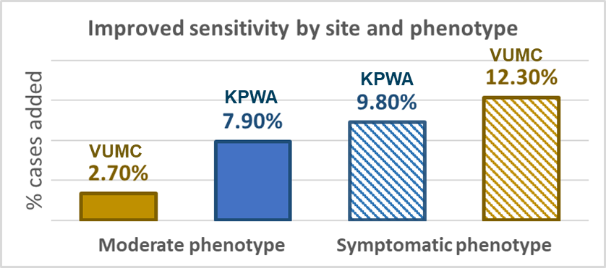
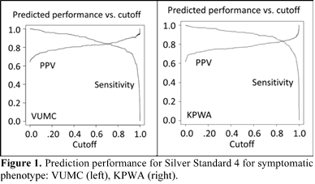
FE2: NLP tools for cohort identification, exposure assessment, covariate ascertainment ("Scalable NLP")
Goal: In two heterogeneous settings develop and validate scalable and reusable NLP tools for leveraging EHR data to address known insufficiencies in existing data and methods to support FDA safety surveillance studies
Progress:
Improving sensitivity of cohort identification
Objective 1: Cohort identification
Developed and evaluated scalable, replicable approaches to cohort identification in Sentinel safety studies
Objective 2: Scalable NLP measures
Develop, apply and evaluate scalable, replicable methods for NLP-based measurement of exposures, symptoms, and outcomes
Objective 3: Evaluation
Products: ICPE 2022 and AMIA 2022 abstracts (at right)
Compare structured data versus NLP for capturing exposures, health outcomes of interest, and covariates
Automated cohort identification model (COVID-19)
Deliverable for the IC: Manuscript describing key products of this work and a GitHub repository of reusable tools and methods for incorporating scalable NLP into Sentinel safety studies
WG Leads: David Carrell, KPWA, Joshua Smith, VUMC; Timeline: 2/1/2021-1/31/2023
Notes:
This slide was submitted to the Innovation Center in late February 2022.

Slide 55
High-sensitivity COVID-19 filter results -- VUMC
VUMC patients identified by COVID-19 "base" and "high-sensitivity" (HSF) filters during study period
Filter rank | COVID-19 filter category | N patients with this filter | N patients with this filter and no higher rank filters | Percent of all patients identified by this filter
1st | Diagnosis of U07.1 "COVID-19" (base #1) | 20,840 | 20,840 | 80%
2nd | Any of 5 other COVID-19 diagnoses (base #2) | 1,898 | 111 | 0.43%
3rd | HSF diagnoses (any of 24) | 7,264 | 3,976 | 15%
4th | HSF procedures (any of 10) | 1198 | 37 | 0.14%
5th | HSF medications (any of 4) | 473 | 181 | 0.70%
6th | HSF problem list in EHR (any of 5) | 9,222 | 892 | 3.4%
Total |  |  | 26,037 | 100%
If we included a 7th filter, PCR+ COVID-19 test (only), 8,825 (+34%) new patients would be added.

Slide 56
High-sensitivity COVID-19 filter results -- KPWA
KPWA patients identified by COVID-19 "base" and "high-sensitivity" (HSF) filters during study period
Filter rank | COVID-19 filter category | N patients with this filter | N patients with this filter and no higher rank filters | Percent of all patients identified by this filter
1st | Diagnosis of U07.1 "COVID-19" (base #1) | 15,678 | 15,678 | 81%
2nd | Any of 5 other COVID-19 diagnoses (base #2) | 1,498 | 166 | 1%
3rd | HSF diagnoses (any of 24) | 5,041 | 2789 | 14%
4th | HSF procedures (any of 10) | 550 | 8 | 0.04%
5th | HSF medications (any of 4) | 91 | 84 | 0.4%
6th | HSF problem list in EHR (any of 5) | 4,845 | 607 | 3%
Total |  |  | 19,332 | 100%
If we included a 7th filter, PCR+ COVID-19 test (only), 4,737 (+25%) new patients would be added.
Notes:
The percentage of patients added by each additional filter (hierarchically) is quite similar in the two study sites.

Slide 57
Automated Methods for Developing Computable Phenotypes
Lessons Learned from : Advancing scalable natural language processing approaches for unstructured electronic health record data
Workgroup Leads: Joshua C. Smith & David S. Carrell
4/28/22

Slide 58
Phenotyping
Computable phenotype algorithms typically:
  Require time-intensive expert curation and feature engineering
  Require manually-annotated gold- standard training sets
  Result in high cost and limited scalability.
PheNorm, and similar automated approaches:
  Based on natural language processing (NLP), machine learning, and (low-cost) silver-standard training labels
  Have been demonstrated to perform well for various chronic health conditions.
We evaluated PheNorm for use with acute conditions (COVID-19)
  PheNorm currently being applied to acute pancreatitis in another IC project

Slide 59
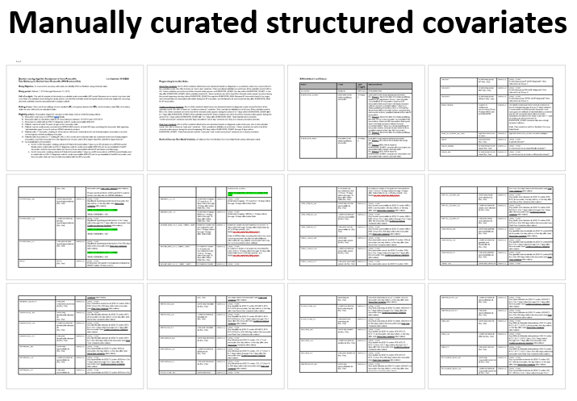
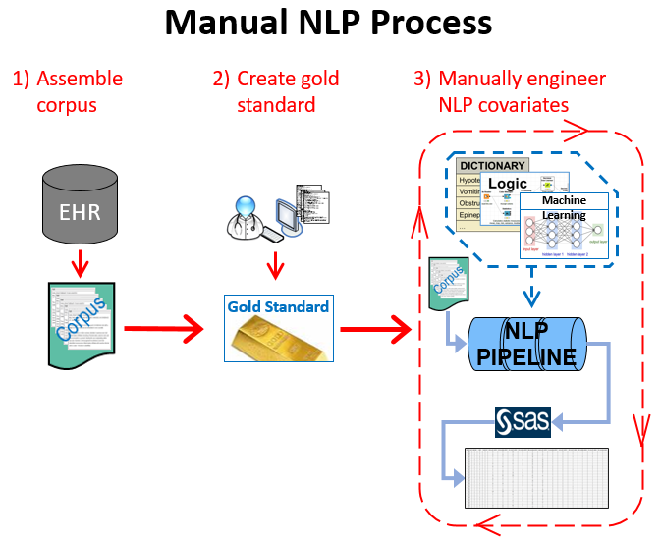
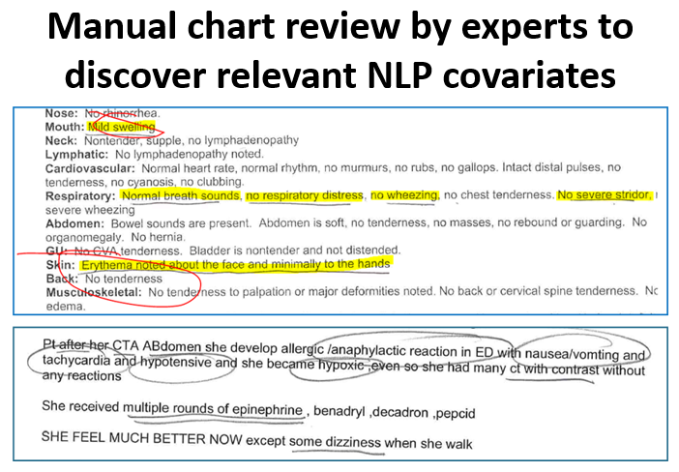
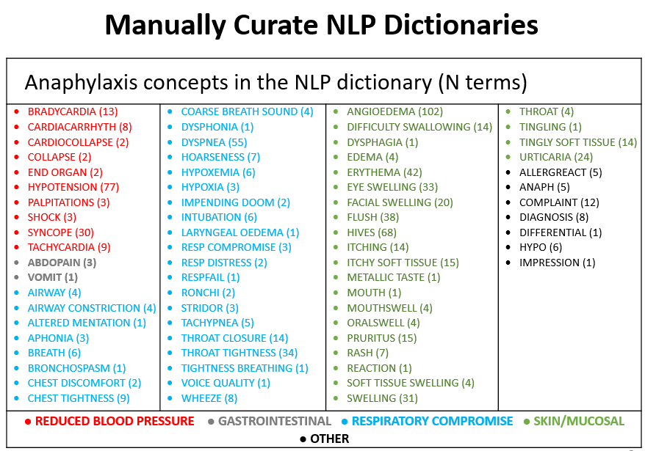
Rationale for exploring automating phenotyping methods
Scalability
  Manual approach is burdensome/slow, requires substantial expertise
Replicability
  Reduced operator-dependence
Hybrid solutions?
  PheNorm → PheCAP → blended methods?

Slide 60
Rationale for exploring automating phenotyping methods
    Continuum of development approaches
Manual development
Expert-driven
Manual engineering
Heavy reliance on gold standard labels
Substantial operator dependence
Slow
Automated development
Data-driven
Automated engineering
Heavy reliance on silver standard labels
Reduced operator dependence
Fast
    Automated feature engineering (AFEP)¹
    Surrogate-assisted feature extraction (SAFE)²
    Phenotype algorithm normalization (PheNorm)³
    Phenotyping common approach (PheCAP)⁴
1. Yu et al. Toward high-throughput phenotyping: unbiased automated feature extraction and selection from knowledge sources. JAMIA 2015
2. Yu et al. Surrogate-assisted feature extraction for high-throughput phenotyping. JAMIA 2017
3. Yu et al. Enabling phenotypic big data with PheNorm. JAMIA 2018
4. Zhang et al. High-throughput phenotyping with EMR data using a common semi-supervised approach (PheCAP). Nature Protocols. 2019

Slide 61
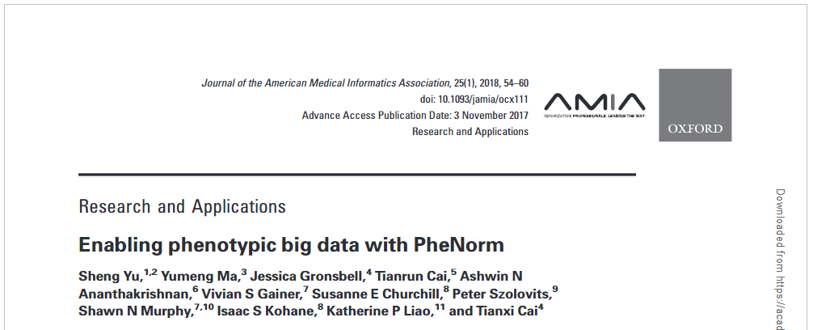
Automated modeling: PheNorm
Sheng Yu, Yumeng Ma, Jessica Gronsbell, Tianrun Cai, Ashwin N Ananthakrishnan, Vivian S Gainer, Susanne E Churchill, Peter Szolovits, Shawn N Murphy, Isaac S Kohane, Katherine P Liao, Tianxi Cai. Enabling phenotypic big data with PheNorm. J Am Med Inform Assoc. 2018 Jan 1;25(1):54-60.
https://pubmed.ncbi.nlm.nih.gov/29126253/

Slide 62

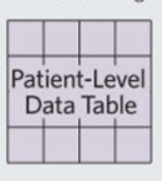
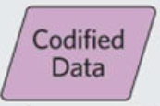
Overview of PheNorm/PheCap
Zheng et al. High-throughput phenotyping with electronic medical record data using a common semi-supervised approach (PheCAP). Nat protocols. 2019 Dec;14(12):3426-3444. doi: 10.1038/s41596-019-0227-6. Epub 2019 Nov 20.
Transfor-mation 1
Transfor-mation 2
Predicted probability of being a case
Phenotype classification
(Yes/No)
AFEP
ICD-10 diagnosis codes for COVID-19 and other diagnosis codes (HSF*)
Cases & non-cases
“Transformations happen”
Index date
Catchment period
Define silver label & counts of DX codes
Feature selection
Transformations
Evaluate using gold-labeled data (not included)

Slide 63
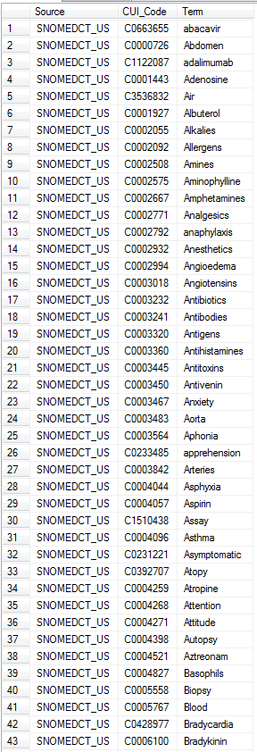
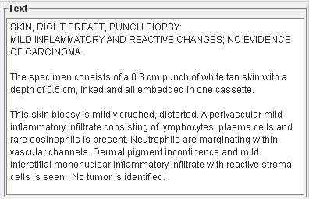
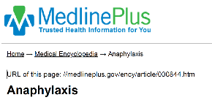

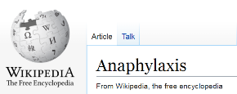
    Automating NLP dictionary creation (AFEP)
Relevant Clinical Vocabularies
5 clinical knowledge base articles on a topic
Candidate relevant concepts
Corpus
Concepts appearing in ≥3 articles
are in the dictionary
NLP
Yu et al. Toward high-throughput phenotyping: unbiased automated feature extraction and selection from knowledge sources. JAMIA 2015

Slide 64
Running PheNorm
AFEP Dictionary
  159 CUIs extracted from 6 articles on COVID-19
Data/text catchment Period
  Index date +/-30 days
Input Data
  KPWA: 143,584 notes from 8,329 patients
  VUMC: Approximately 1.1 million notes from 24,355 patients
Process notes using MetaMapLite
  Transform counts of each NLP-extracted concept from the AFEP dictionary into input vectors for PheNorm

Slide 65
Running PheNorm
Silver Standard Labels
  Structured Label – count of days with U07.1 diagnosis code (COVID-19)
  Structured Label – counts of six COVID-related CUIs
  NLP Label – Cumulative count of “COVID-19” mentions in patients’ charts
  NLP Label – number of days (KPWA) or notes (VUMC) in which a COVID-19 concepts was mentioned in patients charts
  Apply PheNorm, evaluate

Slide 66
COVID-19 Phenotype
Severity of illness scale (NIH)
Evidence of COVID-19 infection
SEVERITY LEVEL | SIGN/SYMPTOM
Asymptomatic | No symptoms
Mild | Fever (>=100.4F)
 | Cough
 | Sore throat
 | Malaise/fatigue
 | Headache
 | Muscle pain
 | Nausea
 | Vomiting
 | Diarrhea
 | Loss of sense of taste or smell
Moderate | Shortness of breath (SpO2 >=94%)
 | Dyspnea (SpO2 >=94%)
 | Abnormal chest imaging (SpO2 >=94%)
Severe | SpO2 <94%
 | PaO2/FiO2* <300 mm Hg
 | Respiratory freq >30 breaths/min
 | Lung infiltrates >50%
Critical | Respiratory failure
 | Septic shock
 | Multiple organ dysfunction
Definite or highly probable infection
  Lab data or clinical note indicates patient was PCR-positive or
  Assertion the patient has COVID-19 in a free text statement or
  Strong evidence of proximal exposure and serologic evidence of prior infection
Probable or possible infection
  Patient symptoms are consistent with a diagnosis of COVID-19
  Absence of an explicit alternative diagnosis and/or absence of a statement that a
  non-COVID-19 cause is more likely
  Strong evidence of proximal exposure
Unlikely infection
  Explicit alternative diagnosis or statement that a non-COVID-19 cause is more likely
  Absence of symptoms consistent with a diagnosis of COVID-19 and absence of lab
  data or clinical note indicating a positive PCR test
Not infected
  No indication in the EHR of infection [i.e., symptoms, exposure, and/or labs/serology]
  during the relevant time window) EHR appears to thoroughly document the patient’s
  care during the relevant time window
Insufficient Information
  EHR appears not to be a reasonably complete source of documentation about the
  patient’s care during the relevant time window
Notes:
So we did manually review a random sample of notes from each site. The chart abstractors criteria is shown here, and they not only identified COVID-19 infection status, but also COVID-19 severity (based on NIH criteria).

Slide 67
COVID-19 phenotype chart review results
Gold standard chart review results by study site and COVID-19 phenotype definition
Study site | COVID-19 phenotype definition | Chart review result | Number of charts | Percent of charts
VUMC (N=483) | Moderate+ severity | Non-case | 334 | 69%
 |  | Case | 149 | 31%
 | Mild+ severity | Non-case | 188 | 39%
 |  | Case | 295 | 61%
KPWA (N=437) | Moderate+ severity | Non-case | 315 | 72%
 |  | Case | 122 | 28%
 | Mild+ severity | Non-case | 168 | 38%
 |  | Case | 269 | 62%
Chart samples were stratified to represent all filter types (not a random sample of all eligible charts)
Notes:
In the end, we reviewed 483 patients from VUMC and 437 patients from KPWA, and determined if they were cases or non-cases, and (among the cases) if they had at least moderately severe disease, or if they only have mild disease.

Slide 68
PheNorm Results – Moderate+ Phenotype
Site | Silver Standard | Phenotype | AUC | Sensitivity at PPV=0.8
KPWA | 1 - U07.1 Days | Moderate+ | 0.700 | 0.07
VUMC | 1 - U07.1 Days | Moderate+ | 0.814 | 0.29
KPWA | 2 - Six-CUI Days | Moderate+ | 0.695 | 0.05
VUMC | 2 - Six-CUI Days | Moderate+ | 0.841 | 0.47
KPWA | 3 - COVID Mentions | Moderate+ | 0.674 | 0.00
VUMC | 3 - COVID Mentions | Moderate+ | 0.775 | 0.29
KPWA | 4A - CUI Days | Moderate+ | 0.695 | 0.00
VUMC | 4B - CUI Notes | Moderate+ | 0.768 | 0.27
Notes:
So, what were our results?

Slide 69
PheNorm Results – Symptomatic COVID-19
Site | Silver Standard | Phenotype | AUC | Sensitivity at PPV=0.8
KPWA | 1 - U07.1 Days | Symptomatic | 0.773 | 0.89
VUMC | 1 - U07.1 Days | Symptomatic | 0.901 | 0.99
KPWA | 2 - Six-CUI Days | Symptomatic | 0.766 | 0.88
VUMC | 2 - Six-CUI Days | Symptomatic | 0.899 | 0.95
KPWA | 3 - COVID Mentions | Symptomatic | 0.864 | 0.98
VUMC | 3 - COVID Mentions | Symptomatic | 0.887 | 0.94
KPWA | 4A - CUI Days | Symptomatic | 0.892 | 0.98
VUMC | 4B - CUI Notes | Symptomatic | 0.875 | 0.95

Slide 70
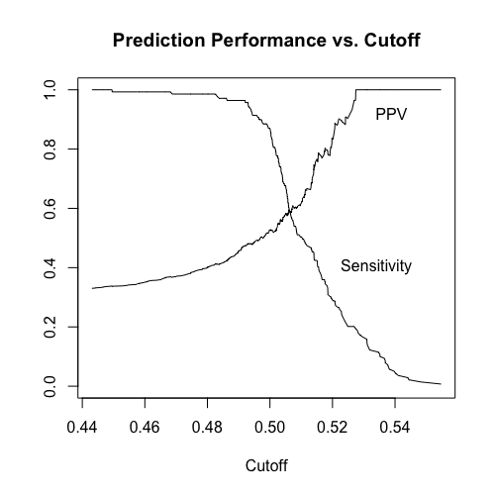
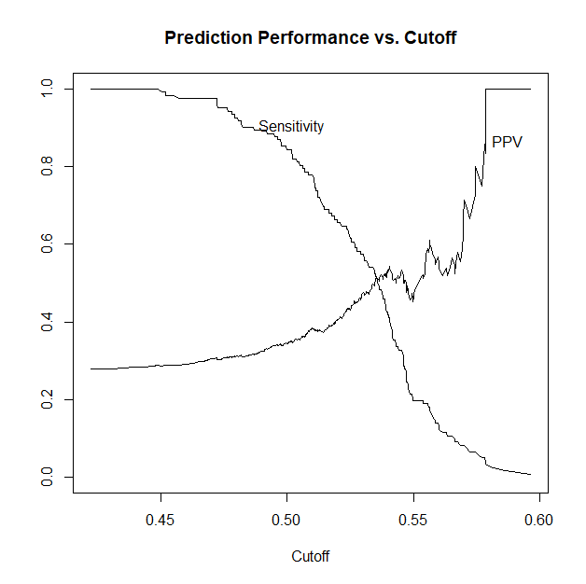
Prediction Performance
Moderate+ phenotype, Silver #1 – U07.1 Days
0.35
0.07
Notes:
This is the moderate phenotype using Silver Label #1. VUMC in gold, KPWA in blue. *click*
You can see here that at 80% PPV in the VUMC data, we get a sensitivity of 35% when using that threshold of 0.52 from the model. *click*
At KPWA, it didn’t perform as well for the moderate phenotype.

Slide 71
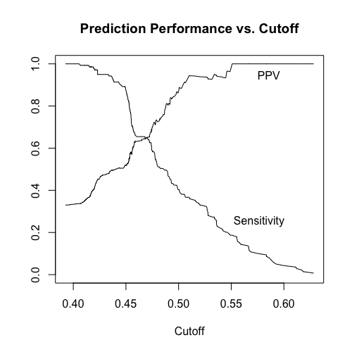
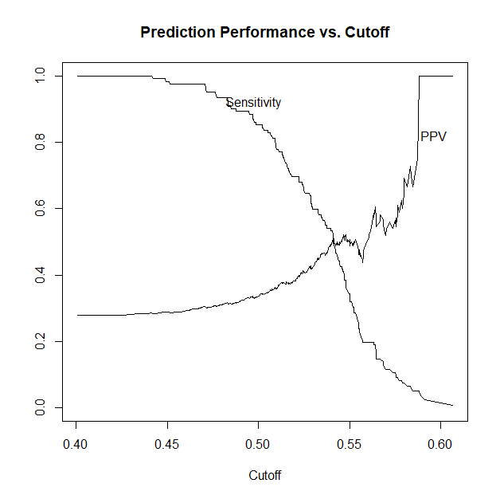
Prediction Performance
Moderate+ phenotype, Silver #2 – “Six-CUI” Days
PPV = 0.80
Sens = 0.47
PPV = 0.80
Sens = 0.05
Notes:
Similarly, for the moderate phenotype, we can see results for second silver label - Six-CUI Days (U07.1, J12.81, J12.82, B34.2, B97.21, B97.29)
VUMC in gold, KPWA in blue

Slide 72
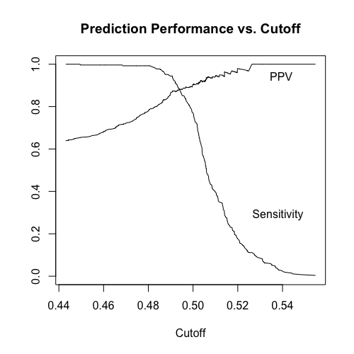
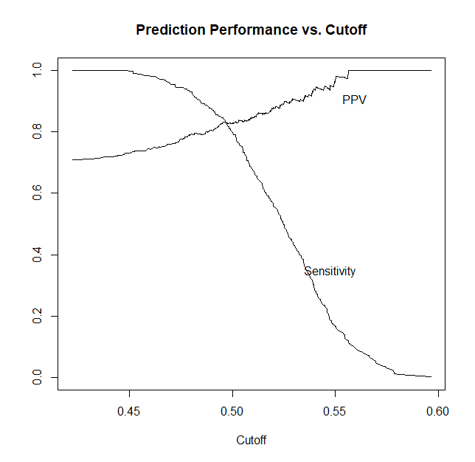
Prediction Performance
Mild+ phenotype, Silver #1 – U07.1 Days
PPV = 0.80
Sens = 0.99
PPV = 0.80
Sens = 0.89
Notes:
However, as shown in the tables, performance for the mild phenotype was much better! This is using silver label #1, the number of days with U07.1 codes…

Slide 73
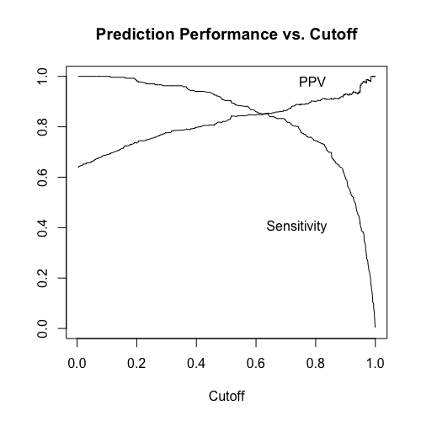
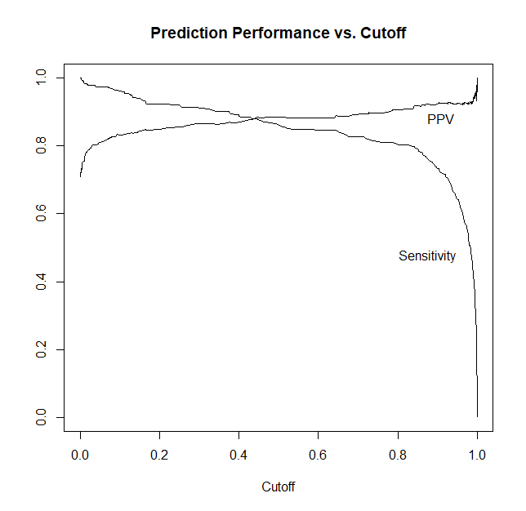
Prediction Performance
Mild+ phenotype, Silver #3 – COVID-19 Mentions
PPV = 0.80
Sens = 0.94
PPV = 0.80
Sens = 0.98
Notes:
And here is the mild phenotype again for silver label 3 – mentions of COVID19 in unstructured text.

Slide 74
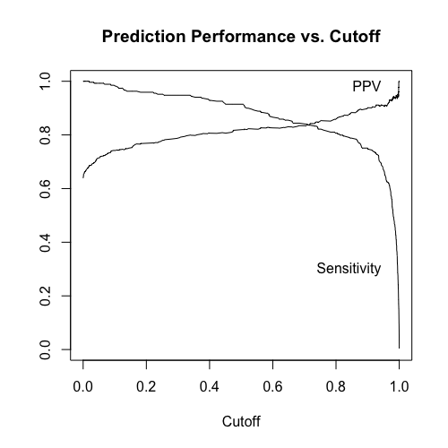
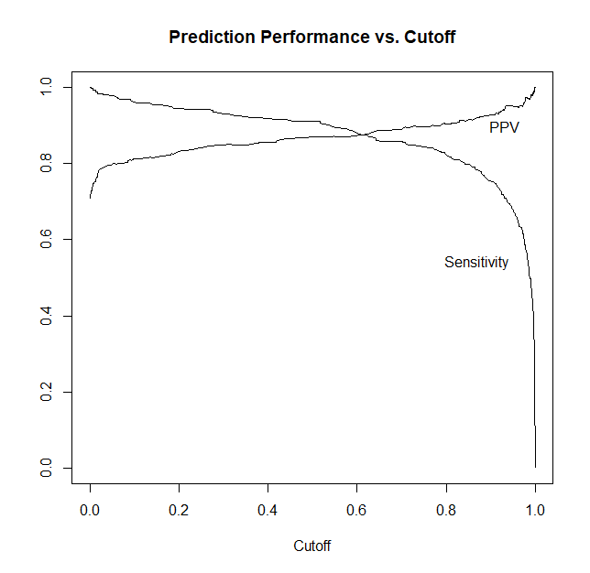
Prediction Performance
Mild+ phenotype, Silver #4 – COVID Notes / COVID Days
PPV = 0.80
Sens = 0.95
PPV = 0.80
Sens = 0.98
Notes:
And they both peform similarly well using silver label 4, number of notes and number of days with a COVID mention

Slide 75
Take-home messages
Relevance to Sentinel safety surveillance
  Relatively modest effort was needed to implement this approach
  Replication in (two) heterogeneous settings was straightforward
  May be relevant for both chronic and acute health conditions
Performance of automated models
  “Fit” between silver label and phenotype definition appears important
  “Fit” between source data and phenotype definition appears important (e.g., inpatient data needed for moderate+ severity)
  When performance is less than desirable, automated approaches may still be a useful starting point for model development
Hybrid approaches – automated and manually-curated features
  PheCap and Multimodal Automated Phenotyping (MAP)
Notes:
By “May be relevant for some acute health conditions” we mean that this method (PheNorm), which was developed for application to chronic health conditions (using EHR data from many patient encounters over a long time period), may also be applicable to some acute conditions (where the relevant EHR data comes from a relatively narrow time window around an acute event).
By “… may be a useful starting point ” we mean an approach where initial modeling is done with fully-automated methods, and then augmented with manually-curated features and use of some gold-labeled data during model training (i.e., the approach described in the PheCAP paper).

Slide 76

More information
Data-driven automated classification algorithms
for acute health conditions: Applying PheNorm
to COVID-19 disease
  Abstract submitted for AMIA 2022 Annual Symposium
Joshua Smith, PhD (VUMC) David Carrell, PhD (KPWA)
joshua.smith@vumc.org david.s.carrell@kp.org

Slide 77

Large-scale Phenotyping With Natural Language Processing
Cosmin Adrian Bejan, PhD
Department of Biomedical Informatics
4/28/22

Slide 78
Desiderata for NLP-based phenotyping
Improve phenotype identification based on structured data
Analyze large volumes of clinical notes
Data-driven generation of phenotype profiles
Minimize the amount of chart review
Generalize across phenotypes
Replicate across EHR repositories

Slide 79
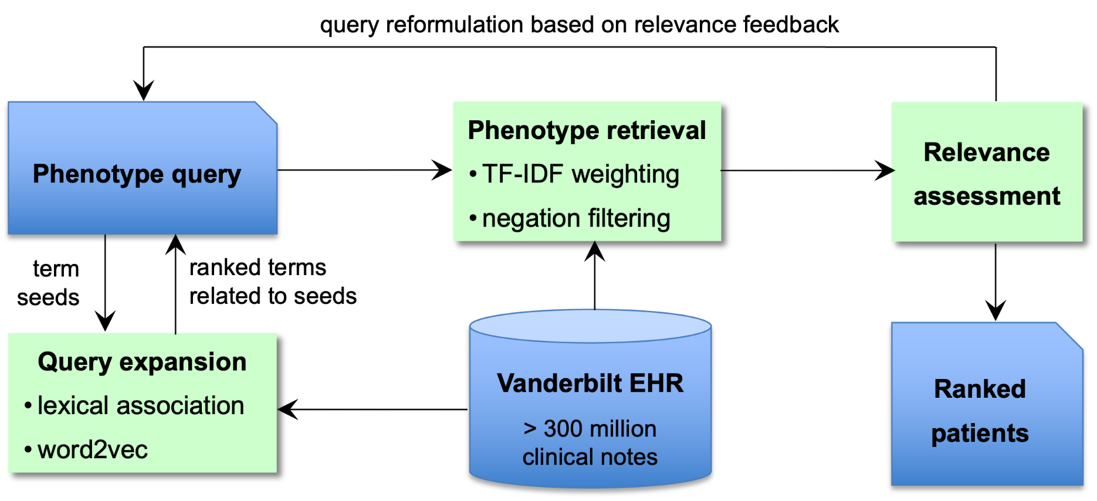
Proposed NLP system architecture
Notes:
Google analogy

Slide 80
Proposed NLP system architecture
1

Slide 81
Proposed NLP system architecture
2

Slide 82
Proposed NLP system architecture
3

Slide 83
Proposed NLP system architecture
4

Slide 84
Applications
Social determinants of health
  Homelessness (VUMC)
  Adverse Childhood Experiences (VUMC)
  Homelessness (OHSU)
  Social Isolation (OHSU)
  Financial Insecurity (OHSU)
  Chronic Stress (OHSU)
Suicide phenotypes
  Suicidal Ideation (VUMC)
  Suicide Attempt (VUMC)
  Suicide Attempt - incidence
(Bejan et al., JAMIA 2018)
(Dorr, Bejan et al., MedInfo 2019)
(Bejan et al., medRxiv 2022)
(Walsh et al., submitted)
Notes:
Common characteristics:
low prevalence
under-coded & under-reported

Slide 85
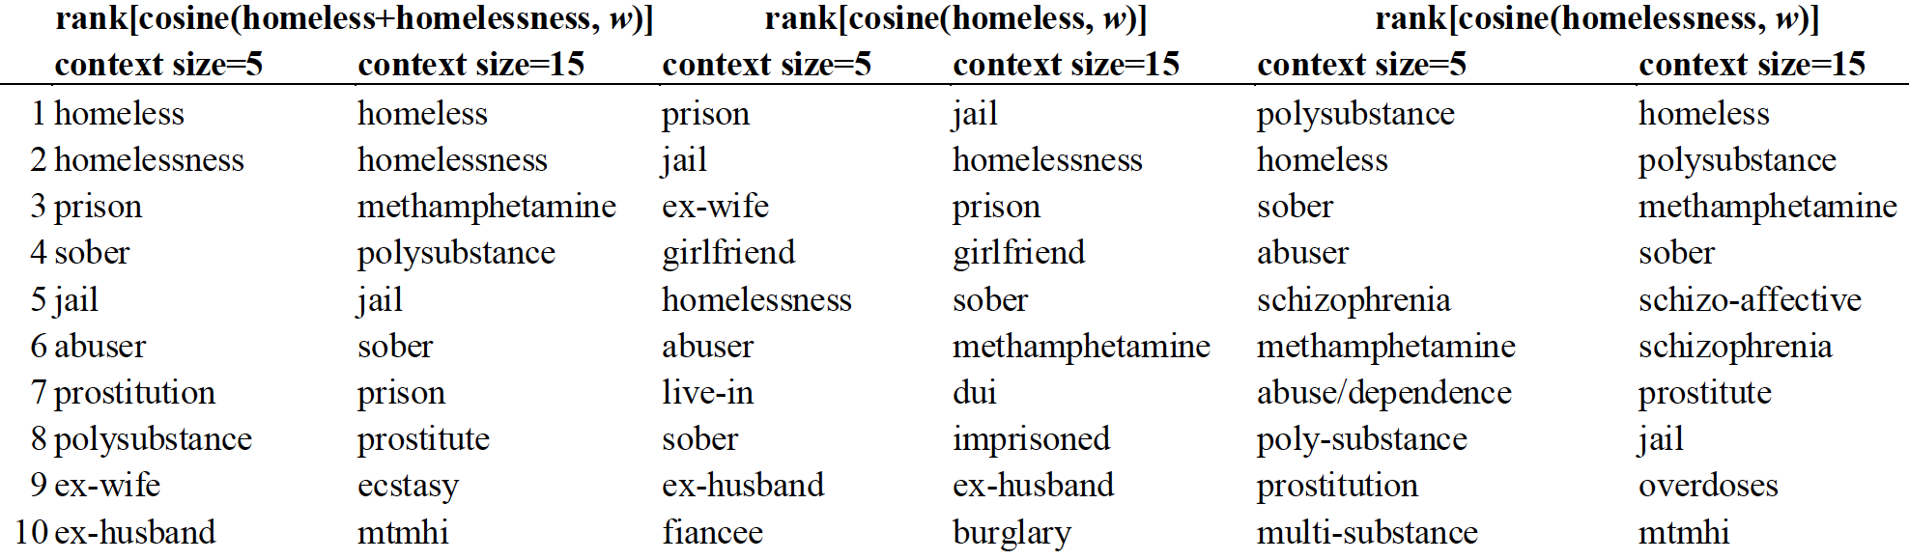
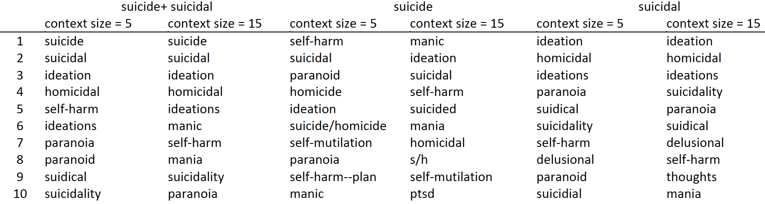
Data-driven methods for extracting phenotype profiles
Homelessness
Suicide phenotypes

Slide 86
Building phenotype queries (I)
ACE
  child abuse
  sexual abuse
  child neglect
  childhood trauma
  child protective service
  physical abuse
  psychological abuse
  verbal abuse
  poverty
  food insecurity
  cps supervisor
  cps report
  cps worker
  cps investigation
Homelessness
  homeless
  homelessness
  shelter
  unemployed
  jobless
  incarceration

Slide 87
Building phenotype queries (II)
Suicidal Ideation
suicid(al|e) idea(tion|s)*
suicid(al|e) thought(s)*
thought(s)* of suicide
(wish|wishes|intent|intend|intends|plans) to commit suicide
(want|wish) (s|ing|es)* to die
(thoughts|think|want|wish) (s|ing|es)* (of|to|about) (take|end) (ing)* (my|his|her|their) (own)* life
(thoughts|think|want|wish) (s|ing|es)* (of|to|about) (kill|shot|shoot|hang|poison|asphyxiate|asphyxiat|mutilate|mutilat|harm|overdose|overdos|cut|cutt|gas|gass|slash) (ing)* (myself|himself|herself|themself)
(thoughts|think|want|wish) (s|ing|es)* (of|to|about) (slit|slitt|cut|cutt|slash) (ing)* (my|his|her|their|the)* (wrist|arm|throat)
feel(s|ing) (very)* suicidal
(thoughts|think|want|wish) (s|ing|es)* (of|to|about) (jump|jumping) off (a|the|interstate|my|his|her|their)* (bridge|building|balcony|window|roof)
(thoughts|think|want|wish) (s|ing|es)* (of|to|about) (jump|jumping) out of (a|the)* moving (vehicle|car)
(thoughts|think|want|wish) (s|ing|es)* (of|to|about) (jump|jumping) from a moving (vehicle|car)
(thoughts|think|want|wish) (s|ing|es)* (of|to|about) (jump|jumping) out of (his|her|the|a)* (\d+) (nd|rd|th) (floor|story|balcony|window)
(thoughts|think|want|wish) (s|ing|es)* (of|to|about) (jump|jumping) in front of a (car|truck|train|vehicle)
(thoughts|think|want|wish) (s|ing|es)* (of|to|about) (jump|jumping) into interstate
(thoughts|think|want|wish) (s|ing|es)* (of|to|about) (jump|jumping) out of (a|the|his|her)* (window|balcony)

Slide 88
Building phenotype queries (III)
Suicide Attempt
suicid(al|e) attempt
suicid(al|e) ideation and attempt
(attempted|committed) suicide
(try|tried|tries|trying|attempted|attempts|attempting) (of|to) (take|end) (ing)* (my|his|her|their) (own)* life
(try|tried|tries|trying|attempted|attempts|attempting) (of|to) (kill|shot|shoot|hang|poison|asphyxiate|asphyxiat|mutilate|mutilat|harm|overdose|overdos|cut|cutt|gas|gass|slash) (ing)* (myself|himself|herself|themself)
(try|tried|tries|trying|attempted|attempts|attempting) (of|to) (slit|slitt|cut|cutt|slash) (ing)* (my|his|her|their|the)* (wrist|arm|throat)
(try|tried|tries|trying|attempted|attempts|attempting) (of|to) (jump|jumping) off (a|the|interstate|my|his|her|their)* (bridge|building|balcony|window|roof)
(try|tried|tries|trying|attempted|attempts|attempting) (of|to) (jump|jumping) out of (a|the)* moving (vehicle|car)
(try|tried|tries|trying|attempted|attempts|attempting) (of|to) (jump|jumping) from a moving (vehicle|car)
(try|tried|tries|trying|attempted|attempts|attempting) (of|to) (jump|jumping) out of (his|her|the|a)* (\d+) (nd|rd|th) (floor|story|balcony|window)
(try|tried|tries|trying|attempted|attempts|attempting) (of|to) (jump|jumping) in front of a (car|truck|train|vehicle)
(try|tried|tries|trying|attempted|attempts|attempting) (of|to) (jump|jumping) into interstate
(try|tried|tries|trying|attempted|attempts|attempting) (of|to) (jump|jumping) out of (a|the|his|her)* (window|balcony)

Slide 89
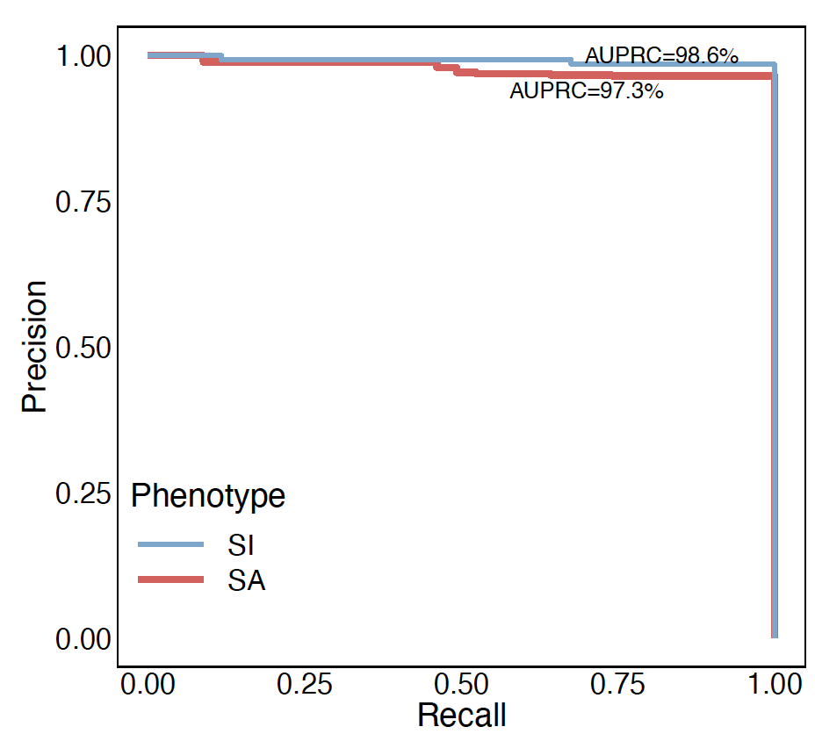
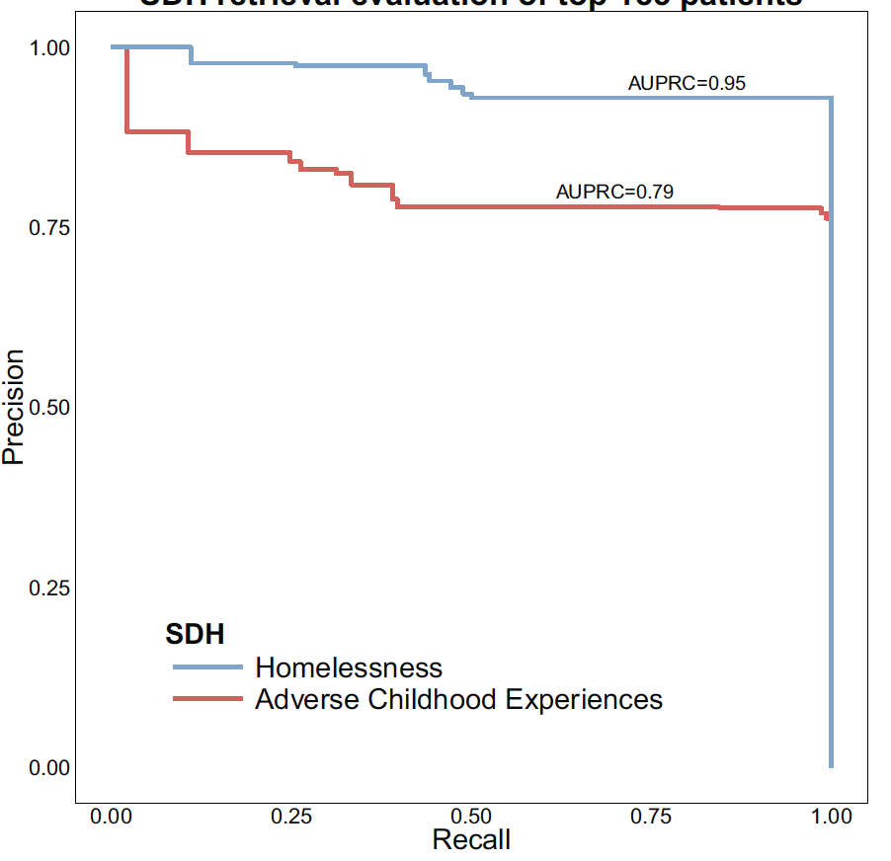
Patient retrieval evaluation (Top K)
Homelessness
P@185 = 93%
N=35,220
ACE
P@185 = 76%
N=27,861
Suicidal Ideation
P@200 = 98.5%
N=187,047
Suicide Attempt
P@200 = 96.5%
N=52,738

Slide 90
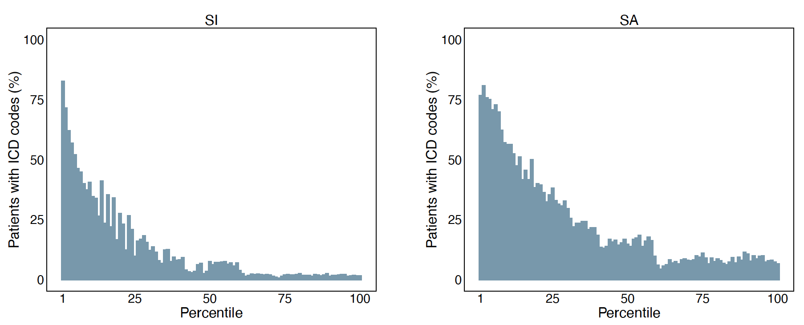
ICD-based identification of suicide phenotypes
Suicidal Ideation
P(ICD10CM) = 96%
Suicide Attempt
P(ICD10CM) = 85%

Slide 91
From ranking to classification
Rank | Patient ID | NLP score | Case label | K | P@K
1 | . | 4,717 | 1 | 1 | 100
2 | . |  | 1 | 2 | 100
2 | . |  | 1 | 3 | 100
3 | . |  | 0 | 4 | 75
4 | . |  | ? | 5 | ?
. | . |  | ? | 6 | ?
. | . |  | ? | . | ?
. | . |  | 1 | . | ?
. | . |  | ? | . | ?
Nrank | . |  | ? | N | ?

Slide 92
From ranking to classification
Rank | Patient ID | NLP score | Case label | K | P@K
1 | . | 4,717 | 1 | 1 | 100
2 | . |  | 1 | 2 | 100
2 | . |  | 1 | 3 | 100
3 | . |  | 0 | 4 | 75
4 | . |  | ? | 5 | ?
. | . |  | ? | 6 | ?
. | . |  | ? | . | ?
. | . |  | 1 | . | ?
. | . |  | ? | . | ?
Nrank | . |  | ? | N | ?
cases
K = ? & P@K=70
non-cases

Slide 93
From ranking to classification
Rank | Patient ID | NLP score | Case label | K | P@K | P(NLP)
1 | . | 4,717 | 1 | 1 | 100 | 1
2 | . |  | 1 | 2 | 100 | 1
2 | . |  | 1 | 3 | 100 | 1
3 | . |  | 0 | 4 | 75 | .99
4 | . |  | ? | 5 | ? | .
. | . |  | ? | 6 | ? | .
. | . |  | ? | . | ? | .
. | . |  | 1 | . | ? | .
. | . |  | ? | . | ? | .
Nrank | . |  | ? | N | ? | 0

Slide 94
From ranking to classification
Rank | Patient ID | NLP score | Case label | K | P@K | P(NLP)
1 | . | 4,717 | 1 | 1 | 100 | 1
2 | . |  | 1 | 2 | 100 | 1
2 | . |  | 1 | 3 | 100 | 1
3 | . |  | 0 | 4 | 75 | .99
4 | . |  | ? | 5 | ? | .
. | . |  | ? | 6 | ? | .
. | . |  | ? | . | ? | .
. | . |  | 1 | . | ? | .
. | . |  | ? | . | ? | .
Nrank | . |  | ? | N | ? | 0
u ~ Uniform(0, 1)

Slide 95
From ranking to classification
Rank | Patient ID | NLP score | Case label | K | P@K | P(NLP)
1 | . | 4,717 | 1 | 1 | 100 | 1
2 | . |  | 1 | 2 | 100 | 1
2 | . |  | 1 | 3 | 100 | 1
3 | . |  | 0 | 4 | 75 | .99
4 | . |  | ? | 5 | ? | .
. | . |  | ? | 6 | ? | .
. | . |  | ? | . | ? | .
. | . |  | 1 | . | ? | .
. | . |  | ? | . | ? | .
Nrank | . |  | ? | N | ? | 0

Slide 96
Probabilistic labeling of cases
P(NLP)
1
N
0
1

Slide 97
Probabilistic labeling of cases
P(NLP)
P(NLP)
+ gold labels
1
1
N
N
0
1
0
1

Slide 98
Probabilistic labeling of cases
P(NLP)
P(NLP)
+ gold labels
P(NLP+ICD)
+ gold labels
1
1
1
N
N
N
0
1
0
1
0
1

Slide 99
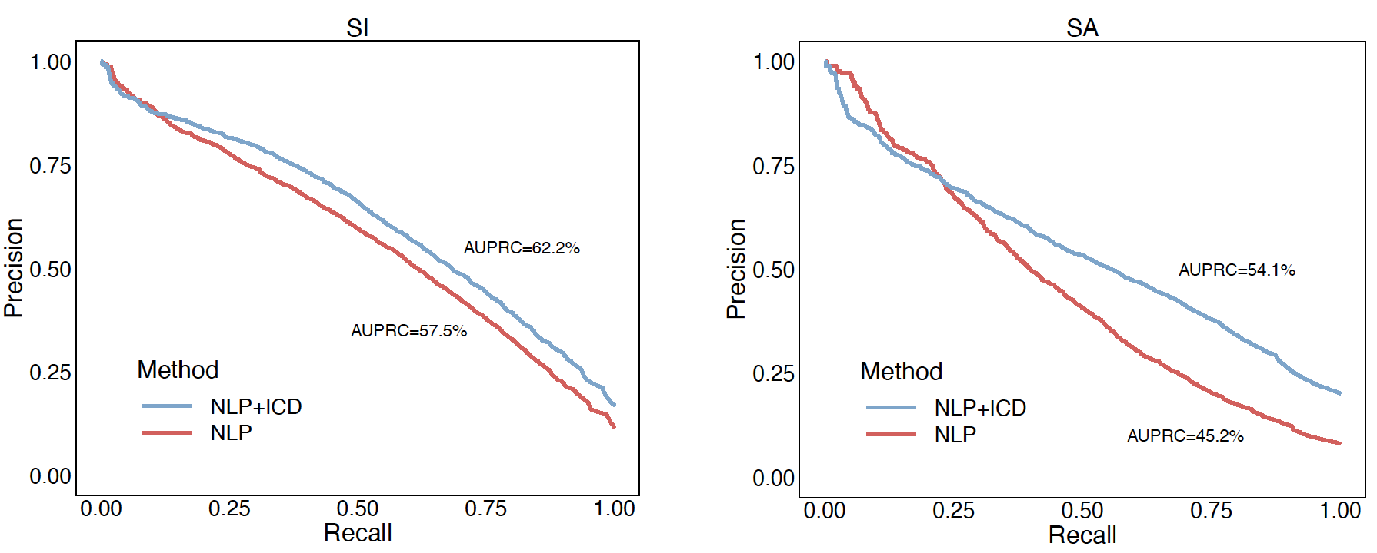
Classification of suicide phenotypes
AUPRC improvement based on negation detection:
  Suicidal ideation: 2.3% (NLP), 3.7% (NLP+ICD)
  Suicide attempt: 0.7% (NLP), 1.2% (NLP+ICD)
NLP vs. NLP+ICD

Slide 100
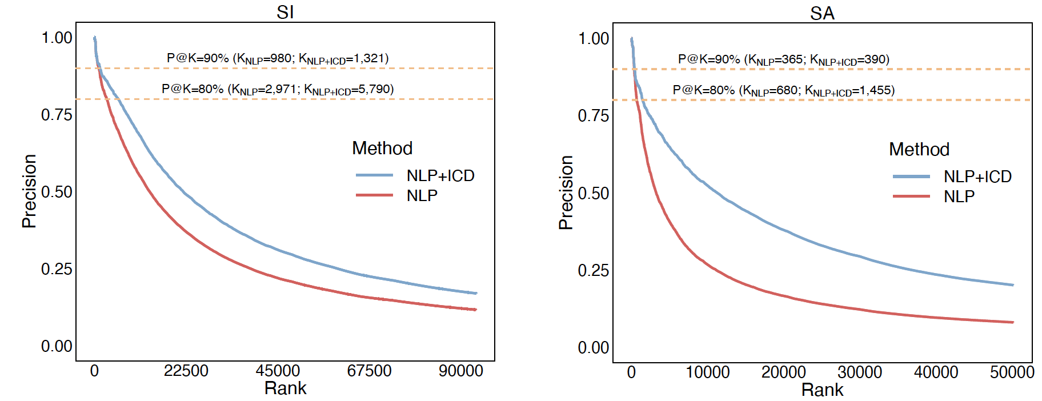
Classification of suicide phenotypes
AUPRC improvement based on negation detection:
  Suicidal ideation: 2.3% (NLP), 3.7% (NLP+ICD)
  Suicide attempt: 0.7% (NLP), 1.2% (NLP+ICD)
NLP vs. NLP+ICD

Slide 101
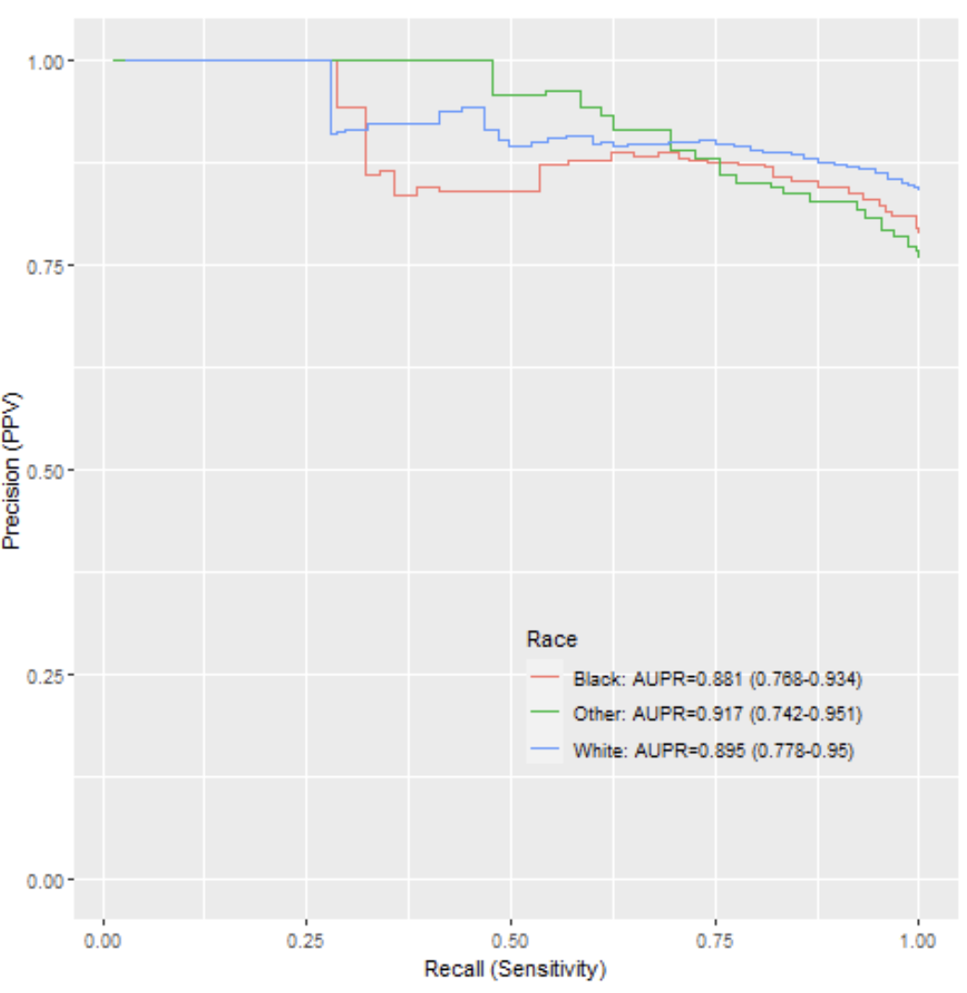
From prevalence to incidence
Phenotype: suicide attempt
Retrieval: “day of notes”
Output: <patient, day>
Weighted sampling of charts
Double chart review
Results:
  263,403 <patient, day> retrieved
  3,566 reviewed charts
  AUPRC range: 0.88-0.92
  Good inter-rater agreement (K=.89)

Slide 102
Conclusions
Scalable NLP system for extracting low-prevalence (under-coded and under-reported) phenotypes from EHR
Proved the generalizability of the method over multiple phenotypes
Showed replication of results across two EHR repositories
Data-driven generation of phenotype profiles leveraging unsupervised learning
Extraction of phenotype cases with high precision
Diagnostic coding and NLP yield optimal ascertainment
Demonstrated the feasibility of the method for identifying incidents of suicide attempt

Slide 103
Acknowledgements
VUMC:
  Katelyn Robinson
  Michael Ripperger
  Drew Wilimitis
  Ryan Ahmed
  JooEun Kang
  Theodore J. Morley
  Jhansi Kolli
  John (Jack) Angiolillo
  Douglas Conway
  Robertson Nash
  Jana K. Shirey-Rice
  Loren Lipworth
  Gabriella Papa
  Robert M. Cronin
  Jill Pulley
  Sunil Kripalani
  William Stead
  Shari Barkin
  Kevin B. Johnson
  Joshua C. Denny
VUMC (cont.):
  Michael Matheny
  Aileen Wright
  Qingxia Chen
  Daniel Fabbri
  Douglas M. Ruderfer
  Colin G. Walsh
FDA:
  Andy D. Mosholder
  Sai H. Dharmarajan
  Danijela Stojanovic
KPWA:
  David Carrell
OHSU:
  David Dorr
  Ana Quinones
  Christie Pizzimenti
  Sumeet Singh
  Matt Storer
Funding :
  U54 MD010722
  R01 LM010685
  R01 GM103859
  UL1 TR000445
  CDRN-1306-04869
  R01 MH121455
  R01 MH116269
  R01 MH118233
  FDA
Harvard:
  Sruthi Adimadhyam
  Shamika More
  Adee Kennedy

Slide 104
Questions?

Slide 105
CI1: Enhancing Causal Inference in the Sentinel System
Priorities | Year 1 | Year 2 | Year 3 | Year 4 | Year 5
 | Master plan | Master plan refinement
Data infrastructure
Identification and queries of potential EHR data partners (Horizon Scan: DI1)
Onboarding EHR data partners
Adding unstructured data and necessary data elements (DI2)
Updating CDM to include EHR data
Source data mapping (DI3)
Data quality metrics and quality assurance strategy
Data governance process
Harmonizing EHRs (DI4)
Data harmonization strategy
FHIR preparedness (DI7)
Death index (DI5)
Feature engineering
Computable phenotyping framework (FE1)
Increasing automation in computable phenotyping
Enhancing transportability of phenotypes
NLP tools for cohort identification, exposure assessment, covariate ascertainment (Scalable NLP: FE2)
NLP tool prototyping and expansion
Improving probabilistic phenotyping of incident outcomes (FE3)
Expanding phenotyping for incident outcomes
Developing NLP-assisted chart abstraction tool (FE4)
Implementing NLP-assisted chart abstraction tool
Causal inference
Evaluating targeted learning in EHR data (Enhancing CI: CI1)
Targeted learning tool development
Performance metrics (CI5)
Causal inference framework (CI2)
Calibration methods (CI4)
Approaches for missing data (CI3)
Distributed regression implementation (CI6)
Detection analytics
Identification and evaluation of EHR detection approaches (DA1)
Empirical evaluation of EHR-based detection approaches (DA2)
Development of EHR-based detection tools
Developing and advancing EHR-based detection methods (DA3)
Methods framework for EHR-based signal detection
Methods for signal detection for pregnancy/birth outcomes (DA4)
Pregnancy and birth outcomes signal detection tool development
Methods for cancer signal detection (DA5)
Cancer signal detection tool development
Innovation incubator
Data Sandbox Discovery Phase
Data Sandbox Implementation Phase

Slide 106
Enhancing Causal Inference in the Sentinel System
Leveraging unstructured electronic health records for large-scale confounding control in real-world evidence studies
Richard Wyss, PhD, MSc
4/1/22

Slide 107

Background

Slide 108
Background: Challenges for Confounding Control in RWE Studies
Confounding arising from non-randomized treatment choices remains a fundamental challenge for extracting valid evidence to help guide treatment and regulatory decisions.
Standard tools for confounding adjustment have typically relied on adjusting for a limited number of investigator specified variables.
  Adjusting for investigator-specified variables alone is often inadequate
    Some confounders are unknown at the time of drug approval
    Many confounders are not directly measured in routine-care databases.

Slide 109
Background: Proxy Confounder Adjustment
Healthcare databases may be understood and analyzed as a high-dimensional set of “proxy” factors that indirectly describe the health status of patients (Schneeweiss 2009, 2017).

Slide 110
Background: High-Dimensional Proxy Confounder Adjustment
How to identify/generate proxy variables for adjustment?
  High-dimensional propensity score (Schneeweiss 2009)
    Does not require data pre-processing
  OMOP approach:
    Pre-process data into a common data model then use machine learning algorithms for variable selection (e.g., Lasso)
Current approaches for generating proxy variables for confounder adjustment do not leverage information from unstructured EHR text notes.

Slide 111
Background: Leveraging Unstructured Electronic Health Records for Large-Scale Proxy Adjustment.
NLP tools turn free-text notes from EHR data into structured features that can supplement confounding adjustment.
  However, traditional applications are difficult to scale for large-scale proxy adjustment.
Project Objective 3 (use of NLP-generated information from unstructured data): To explore if unsupervised NLP can be used to generate high-dimensional sets of features from free-text notes for improved large-scale proxy confounding control
  Aim 1: To use scalable applications of NLP to generate structured features from high-dimensional data for large-scale proxy adjustment.
    leverages work from RO1 (Josh Lin, PI; Richie Wyss, Co-PI; Sebastian Schneeweiss, Co-PI)
  Aim 2: To better understand what machine learning tools for confounder selection perform well for large-scale proxy adjustment in ultra high-dimensional RWE studies.

Slide 112
Methods

Slide 113
Methods: Data Source for Generating Cohort Studies
Mass General Brigham (MGB) Research Patient Data Registry (RPDR)
  The electronic health records (EHR) of all the patients aged 65 and above identified in the Mass General Brigham (MGB) Research Patient Data Registry (RPDR) were linked to Medicare claims data
Linked RPDR-Medicare claims were used to generate 3 cohort studies comparing different classes of medications (details on later slide).
  Purpose: case studies for evaluating and testing various methods for NLP feature generation for ultra high-dimensional proxy confounder adjustment.

Slide 114
Methods: Using NLP to Generate Structured Features.
We used ‘bag-of-words’ to generate features for the top 20,000 most prevalent terms from free-text notes.
  Very common, simple, and flexible NLP approach
  Measures the frequency (occurrence) of words within a document
    Order and structure of words in the document is discarded.
    The model is only concerned with whether words occur in the document, not where in the document or in relation to other words
Each word count is then a feature that can be used for modeling

Slide 115
Methods: Study Cohorts
Table 1. Study Cohorts
 |  | Total N |  |  | # Baseline Covariates
No. | Description | Study Population | Treatment (%) | Outcome (%) | Investigator Specified | Claims Codes | EHR features
1. | High vs low intensity statin with an outcome of major cardiac events | 3,529 | 1,244 (35.3) | 138 (3.9) | 39 | 18,409 | 20,017
2. | Oral anti-coagulants vs non-use with an outcome of stroke and major bleeding | 9,571 | 5,991 (62.6) | 158 (1.7) | 39 | 19,517 | 20,051
3. | High vs. low dose PPI with an outcome of peptic ulcer complications | 20,862 | 7,108 (34.1) | 234 (1.1) | 39 | 28,041 | 20,025

Slide 116
Methods: How to best identify confounder information in ultra high-dimensional real-world data?
Predictive performance did not improve when modeling the outcome, but does this mean that there is no additional confounder information in EHR generated variables?
Begin by considering various methods for confounder selection
  Focus on lasso-based approaches
        Regular Lasso
        Outcome adaptive lasso
        Collaborative controlled lasso
        Outcome highly-adaptive lasso

Slide 117
Methods: How to make objective decisions on which modeling approach is best?
  Cannot use actual study with estimated effects to make modeling decisions
  Recent papers have proposed using synthetic control studies to help assess validity of alternative causal inference models and tailor analyses to the given study (Alaa & Van Der Scharr 2019; Schuler et al. 2017; Athey S et al. 2019; Bahamyirou A., et al. 2018; Schuemie MJ, et al. 2018; Petersen et al. 2012)
    Provides an objective assessment of validity and model selection.
    A common theme is that they use a variation of ‘plasmode simulation’ (Franklin et al. 2014).
Variation of the parametric bootstrap where we bootstrap from the original study population, but simulate some aspects of the data structure while leaving other features of the data unchanged.
Typically, we set the outcome data aside (outcome blind data), then simulate the outcome while leaving baseline covariates and treatment status unchanged.
Try to generate synthetic control outcomes (and treatment) that mimic as closely as possible the observed confounding structure in the study cohort.
Will be inexact, but close approximations can be useful for testing robustness and validity of causal inference methods for the study at hand.

Slide 118
Confounder Selection & Propensity Score Models
Lasso PS Models | Description
Standard Lasso | Lasso modeling treatment assignment with penalty factor (lambda) that optimizes CV treatment prediction
CTMLE Lasso w/ predictions | Collaborative controlled lasso—Lasso modeling treatment assignment but uses ctmle to choose penalty factor. We include initial predictions for the counterfactual outcomes using an outcome lasso model.
CTMLE Lasso w/ no predictions | Collaborative controlled lasso—Lasso modeling treatment assignment but uses ctmle to choose penalty factor. We did not include initial predictions for the counterfactual outcomes (only included treatment in the initial outcome model).
Outcome Adaptive Lasso (OAL) | adaptive lasso modeling treatment assignment with a penalty factor set by user. We assigned a penalty of 0 for all variables selected by the outcome lasso and a penalty of 1 for all other variables (i.e., we forced variables selected by outcome lasso into the lasso model for treatment).
CTMLE OAL w/ predictions | Collaborative controlled outcome adaptive lasso with initial predictions for the counterfactual outcomes
CTMLE OAL w/ no predictions | Collaborative controlled outcome adaptive lasso with no initial predictions for the counterfactual outcomes (initial outcome model includes only treatment)
For each PS model, we estimated the treatment effect using Targeted Maximum Likelihood Estimation (TMLE) that included initial predictions from an outcome lasso model and PS weighting

Slide 119
Simulation Results

Slide 120
Selected Simulation Results for Prediction

Slide 121
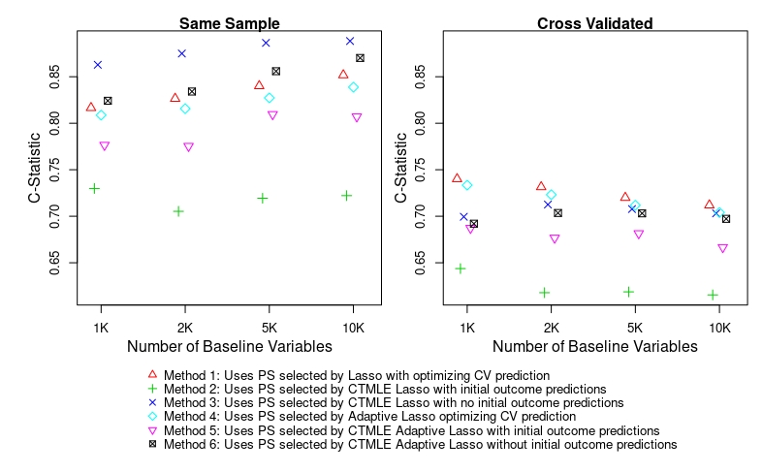

Slide 122
Selected Simulation Results for Bias

Slide 123
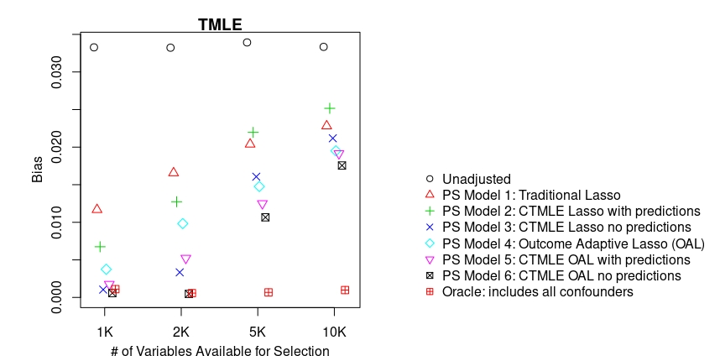
Lambda Selection for Lasso PS Model

Slide 124
General points for discussion
Selecting models based on collaborative learning improved bias reduction even though predictive performance declined.
    Outcome adaptive lasso with collaborative selection generally performed best.
    Some degree of overfitting is beneficial for confounding control when using Machine Learning to data-adaptively select (model) high-dimensional sets of variables
Bias increased as the number of spurious variables available for selection increased.
  Bias can result from two sources
    Lasso model not selecting confounding variables
    Even when lasso selects confounders there can still be regularization bias (Chernozhukov 2018).
Use relaxed lasso to reduce regularization bias in sparse high-dimensional data (Meinshausen 2007).

Slide 125
Relaxed lasso
Use relaxed lasso to reduce regularization bias (Meinshausen 2007).
  Runs regularized regression twice:
    First runs lasso to select lambdas to control variable selection (which variables are selected for each lambda);
    Second step runs regularized regression again for each set of variables selected by each lambda with less penalization to control shrinkage level of coefficients. The shrinkage penalization in the second step can be selected using Cross Validation.
  ‘Idea of the relaxed lasso is to take the lasso fitted object and then for each lambda, refit the variables in the active set with either no penalization or less penalization. This gives the “relaxed” fit’. (Hastie & Tibshirani 2021)
  Relaxed lasso can often improve predictive performance by fitting more parsimonious models with less penalization in sparse high-dimensional data (Meinhausen 2007).

Slide 126
Selected Simulation Results for Variable Selection and Prediction with Relaxed Lasso

Slide 127
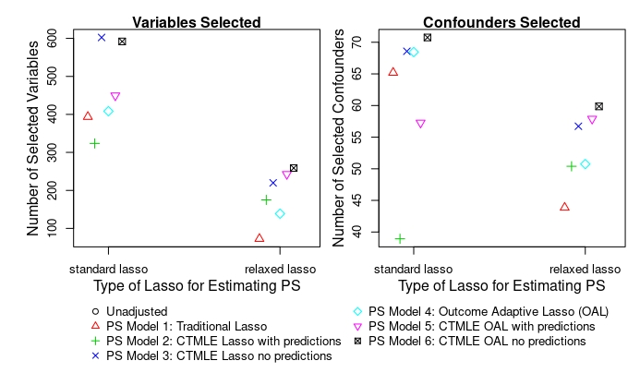

Slide 128
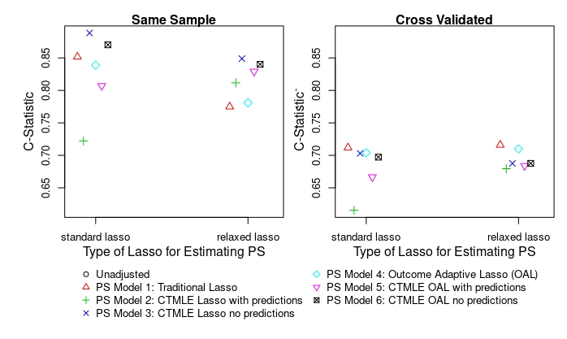

Slide 129
Selected Simulation Results for Bias with Relaxed Lasso

Slide 130
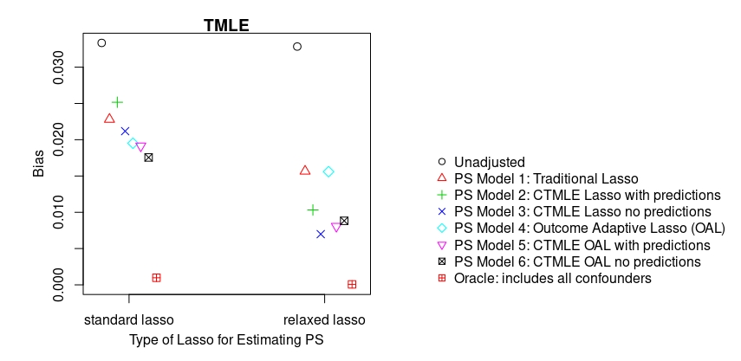

Slide 131
Discussion

Slide 132
General Points for Discussion after running ‘relaxed’ lasso
Relaxed lasso reduced bias in effect estimate compared with standard lasso
Selecting models based on collaborative learning still improved bias reduction at the expense of predictive performance.
  Outcome adaptive lasso with collaborative selection generally performed best.
  Some degree of overfitting is beneficial for confounding control when using Machine Learning to data-adaptively select (model) high-dimensional sets of variables
Still some bias with large numbers of variables
  May need large samples to use ML to identify confounders in sparse high-dimensional data.

Slide 133
Future work/next step is to apply top performing models from simulations to empirical studies

Slide 134
Research team
Food and Drug Administration Hana Lee, PhD, MS Sarah Dutcher, PhD, MS | Brigham and Women’s Hospital Richard Wyss, PhD, MS Rishi Desai, PharmD, PhD Josh Lin, MD, PhD Shirley Wang, PhD, MS Yinzhu Jin, MS, MPH Shamika More, MS Luke Zabotka, BA
DPM/HPHCI/Operations Center Darren Toh, ScD | Kaiser Washington/University of Washington Jennifer Nelson, PhD
University of California, Berkeley Mark van der Laan, PhD Lars van der Laan | University of Michigan Xu Shi, PhD
Putnam Data Sciences Susan Gruber, PhD, MS, MPH

Slide 135
Questions?

Slide 136
CI2: A causal inference framework for Sentinel
Priorities | Year 1 | Year 2 | Year 3 | Year 4 | Year 5
 | Master plan | Master plan refinement
Data infrastructure
Identification and queries of potential EHR data partners (Horizon Scan: DI1)
Onboarding EHR data partners
Adding unstructured data and necessary data elements (DI2)
Updating CDM to include EHR data
Source data mapping (DI3)
Data quality metrics and quality assurance strategy
Data governance process
Harmonizing EHRs (DI4)
Data harmonization strategy
FHIR preparedness (DI7)
Death index (DI5)
Feature engineering
Computable phenotyping framework (FE1)
Increasing automation in computable phenotyping
Enhancing transportability of phenotypes
NLP tools for cohort identification, exposure assessment, covariate ascertainment (Scalable NLP: FE2)
NLP tool prototyping and expansion
Improving probabilistic phenotyping of incident outcomes (FE3)
Expanding phenotyping for incident outcomes
Developing NLP-assisted chart abstraction tool (FE4)
Implementing NLP-assisted chart abstraction tool
Causal inference
Evaluating targeted learning in EHR data (Enhancing CI: CI1)
Targeted learning tool development
Performance metrics (CI5)
Causal inference framework (CI2)
Calibration methods (CI4)
Approaches for missing data (CI3)
Distributed regression implementation (CI6)
Detection analytics
Identification and evaluation of EHR detection approaches (DA1)
Empirical evaluation of EHR-based detection approaches (DA2)
Development of EHR-based detection tools
Developing and advancing EHR-based detection methods (DA3)
Methods framework for EHR-based signal detection
Methods for signal detection for pregnancy/birth outcomes (DA4)
Pregnancy and birth outcomes signal detection tool development
Methods for cancer signal detection (DA5)
Cancer signal detection tool development
Innovation incubator
Data Sandbox Discovery Phase
Data Sandbox Implementation Phase

Slide 137
A Causal Inference Framework for Sentinel
Rishi J Desai, PhD,
Assistant Professor, Division of Pharmacoepidemiology and Pharmacoeconomics,
Brigham and Women’s Hospital, Harvard Medical School,
Boston, MA
4/28/22

Slide 138
Background and motivation

Slide 139

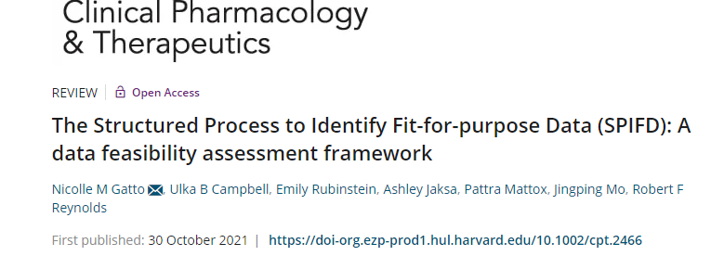
Why do we need another framework?
Quality assessment tools
Reporting tools
Best practices
Misc: Highly specific or focusing on parts of the process

Slide 140
Why do we need another framework?
What do we have?
Various tools exist in the literature for quality assessment, reporting, and describing best practices for pharmacoepidemiologic research
What don’t we have?
None of these tools offer a general framework to guide decision making at various steps along the way
Vision for a framework to guide principled investigations using non-randomized, secondary data
The Sentinel Innovation Center is developing a causal inference framework proposing a stepwise process that systematically considers key choices with respect to design and analysis that influence the validity of studies conducted with non-randomized, secondary data
A standardized “industrial” process that will be outlined in this framework will serve as a guide to inform the conduct of non-randomized secondary database studies of drug-outcome evaluation
Key considerations to meet the FDA need of informing regulatory decision making based on such investigations
  Limit variations across investigators by outlining a general process
  Focus on repeatability of the process
  Written and endorsed by independent experts

Slide 141
A draft of the proposed framework

Slide 142
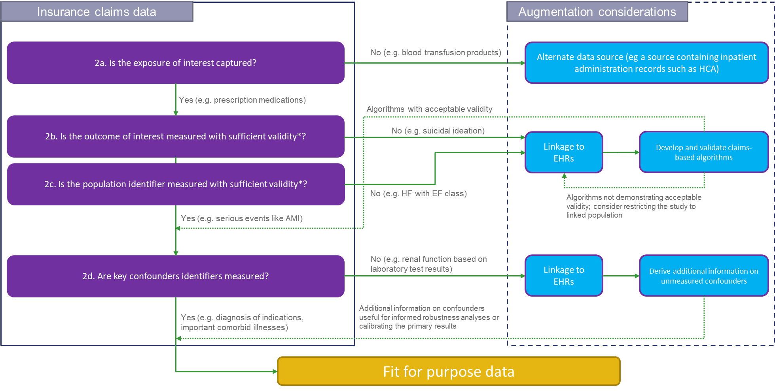
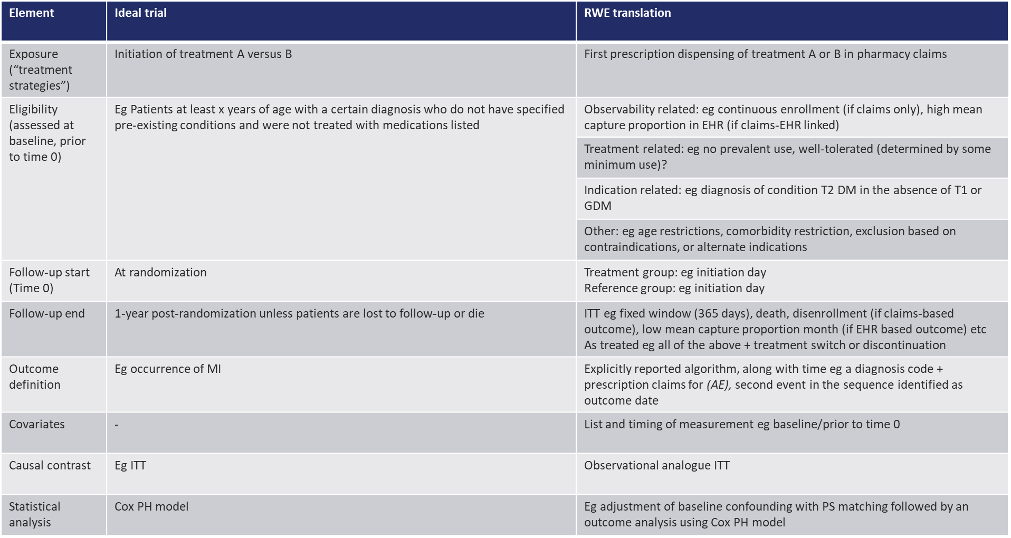
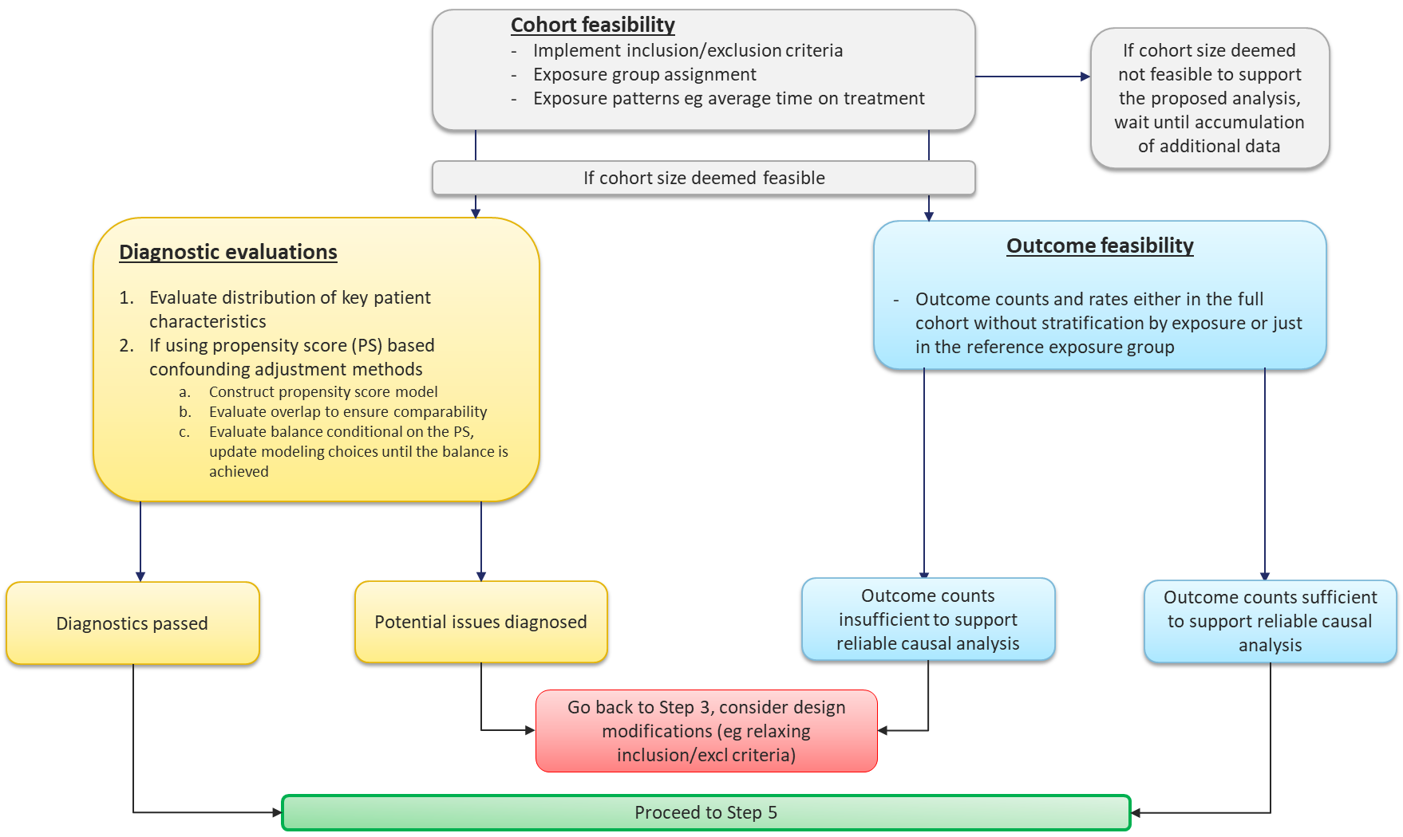

A working draft of a causal inference framework for Sentinel
STEP 1
Study planning
Well defined research question in the target trial framework specifying PICOTS
STEP 2
Determining fit-for-purpose data source
See Figure for Step 2
STEP 3
Refining target trial parameters and translate to RWE study parameters
See Figure for Step 3
STEP 4
Feasibility assessment
See Figure for Step 4
STEP 5
Robustness evaluations
See Figure for Step 5
Inference
STEP 6
Inferential analysis

Slide 143
Step 1: Well defined research question in the target trial framework specifying PICOTS
First and non-negotiable step in any framework that intends to generate causal inference from observed data
Target trial framework, which is conceptualized as envisioning a hypothetical prospective randomized controlled trial, provides a useful and practical device to sharply define a causal question of interest
Explicit identification of the following key study parameters
  patient population (P)
  the intervention (I) specifying the medical product under investigation,
  a comparator group (C)
  the outcome (O) along with an appropriate time horizon (T)
  setting (S) where the study is implemented
Hernan. AJPH. 2018; 08:616-619
Hernan and Robins. Am J Epidemiol. 2016;183:758-764
Guidance from the AHRQ’s Evidence-based Practice Centers Program

Slide 144
Step 2: Determining fit-for-purpose data sources
Insurance claims data
Incorporating additional sources
2a. Is the exposure of interest captured?
No (e.g. blood transfusion products)
Alternate data source (e.g. a source containing inpatient administration records such as HCA)
Yes (e.g. prescription medications)
Algorithms not demonstrating acceptable validity*; consider restricting the study to linked population
2b. Is the outcome of interest measured with sufficient validity*?
No (e.g. pancreatitis)
Linkage to EHRs
Develop and validate claims-based algorithms
2c. Is the population identifier measured with sufficient validity*?
No (e.g. HF with EF class)
Yes (e.g. serious events like AMI)
Algorithms with acceptable validity
2d. Are key confounders identifiers measured?
No (e.g. renal function based on laboratory test results)
Linkage to EHRs
Derive additional information on unmeasured confounders
Yes (e.g. diagnosis of indications, important comorbid illnesses)
Additional information on confounders useful for informed robustness analyses or calibrating the primary results
Fit for purpose data
* Validity as demonstrated by parameters including PPV, sensitivity, specificity for binary outcomes; proportion missing for continuous outcomes; and accurate onset for time to event outcomes and availability of long-term follow-up data for latent outcomes

Slide 145
Step 3: Refining target trial parameters¹ and translate to RWE study parameters
(Using a hypothetical example case study of SGLT2 inhibitors and the risk of genital infection in a claims-EHR linked data source)
Element | Ideal trial | RWE translation
Exposure (“treatment strategies”) | Randomly assigned initiation of SGLT2i (canagliflozin, dapagliflozin, empagliflozin) versus a DPP4 inhibitors | First prescription dispensing of SGLT2i (canagliflozin, dapagliflozin, empagliflozin) or DPP4 inhibitors identified based on pharmacy claims
Eligibility (assessed at baseline, prior to time 0) | Patients aged 18 years or older, with type 2 diabetes mellitus, and no use of study medications before randomization | Observability related: continuous enrollment for 12 months and >80% mean capture proportion² in EHRs before study medication initiation
 |  | Treatment related: No prior use of study medications
 |  | Indication related: Diagnosis of type 2 diabetes based on diagnosis codes or HbA1c results
 |  | Other: Age 18 or older
Follow-up start (Time 0) | At randomization | At prescription dispensing
Follow-up end | 1-year post-randomization unless patients are lost to follow-up or die or have the outcome | Earliest of the outcome, death, insurance disenrollment, or 1-year post initiation
Primary outcome | Hospitalization for genital infections | Hospitalization for genital infections assessed based on primary discharge diagnosis codes
Baseline covariates | - | Demographics, diabetes severity related variables including micro and macrovascular complications and laboratory test results such as HbA1c and serum creatinine, comorbid conditions, comedications, markers for healthy behavior and healthcare utilization
Causal estimand | Intent-to-treat (ITT) | Observational analogue of ITT
Statistical analysis | A Cox proportional hazards model | Adjustment of baseline confounding with propensity score matching followed by an outcome analysis using a Cox proportional hazards model
Subgroup analyses | Stratified by gender | Same as ideal trial
1Hernan and Robins. Am J Epidemiol. 2016;183:758-764; Hernan. N Engl J Med. 2021;385(15):1345-1348
2 Lin et al. Epidemiology 2018;29: 356–363

Slide 146
Step 4: Feasibility analysis
  Cohort feasibility
  Implement inclusion/exclusion criteria
  Exposure group assignment
  Exposure patterns e.g. average time on treatment
If cohort size deemed not feasible to support the proposed analysis, wait until accumulation of additional data
If cohort size deemed feasible
Diagnostic evaluations
Evaluate distribution of key patient characteristics
If using propensity score (PS) based confounding adjustment methods
  Construct propensity score model
  Evaluate overlap to ensure comparability
  Evaluate balance conditional on the PS, update modeling choices until the balance is achieved
Outcome feasibility
Outcome counts and rates either in the full cohort without stratification by exposure or just in the reference exposure group
Diagnostics passed
Potential issues diagnosed
Outcome counts insufficient to support reliable causal analysis
Outcome counts sufficient to support reliable causal analysis
Go back to Step 3, consider design modifications (e.g. relaxing inclusion/excl criteria)
Proceed to Step 5

Slide 147
Step 5: Pre-specification of robustness evaluations
Robustness evaluations
Deterministic sensitivity analyses
Varying design assumptions, variable measurement methods, or analytic choices
Quantitative bias analyses
Net bias analysis
Control/tracer analysis
For exposure/outcome misclassification
Probabilistic sensitivity analysis¹
For unmeasured confounding
E.g. Array or rule out methods²
Trial calibration*
Duplicating inclusion/exclusion criteria and all design aspects of the trial to evaluate whether primary outcome is replicable in the data source³
*such trial may not always exist
Control analysis
Negative control exposure/outcome⁴
1 Fox et al. International Journal of Epidemiology 2005;34:1370–1376
2 Schneeweiss. Pharmacoepiemiology Drug Saf 2006; 15: 291–303
3 Khosrow-Khavar et al. Annals Rheum Dis. 2022
4 Lipsitch et al. Epidemiology 2010;21: 383–388

Slide 148
Summary and next steps
Continuing to fine tune the framework steps
Conducting a demonstration project to highlight how decisions are made at each step along the way and walk users through the steps based on a realistic case-example
The goal is dissemination of this framework in peer-reviewed publication by early next year

Slide 149
Questions?

Slide 150
Closing remarks
Through initiatives such as those discussed today, Sentinel Innovation Center is making strides in helping to achieve the FDA’s vision of a Medical Data Enterprise with a query-ready system containing >10 million EHR lives
Key research needs have been identified and ongoing research projects are addressing some salient challenges presented by EHRs in 4 key domains
  Data infrastructure
  Feature engineering
  Causal inference
  Detection analytics
Highly interdisciplinary research work being conducted at the Innovation Center involving experts in the fields of epidemiology, informatics, medicine, and statistics, will generate unique insights regarding meaningful use of EHRs for clinical research and provide practical solutions

Slide 151


Slide 152






Innovation Center collaborating organizations
Lead sites:

Slide 153
Thank you

