Slide 1
Real-World Evidence Conference
October 24-25
Philadelphia, PA

Slide 2
Natural Language Processing in Pharmacoepidemiology: Lessons from the Multi-source Observational Safety study for Advanced Information Classification using NLP (MOSAIC-NLP)
Jenna Wong, PhD, MSc
Harvard Pilgrim Health Care Institute

Slide 3
Disclaimer
This project was supported by Task Order 75F40119F19002 under Master Agreement 75F40119D10037 from the US Food and Drug Administration (FDA).
The views expressed in this presentation are those of the authors and do not necessarily represent the official views of the U.S. FDA.
The views and opinions expressed in the following PowerPoint slides also should not be attributed to DIA, its directors, officers, employees, volunteers, members, chapters, councils, Communities or affiliates.
This presentation is incomplete without accompanying verbal commentary.

Slide 4
Project Team
FDA
Oracle Life Sciences/ Oracle Health
National Jewish Health
John Snow Labs
Sarah Dutcher, Epidemiologist
Jummai Apata, Epidemiologist
Robert Lim, Medical Officer
Jie (Jenni) Li, Epidemiologist
Jamal Jones, Epidemiologist
Yong Ma, Biostatistician
Tiffany Austin, Project Manager
Elise Berliner, Principal Investigator
Dena Jaffe, Principal Investigator, Epidemiologist
Jenny Cai, Project Manager
Sonam Lama, Project Manager
Nathan Vavroch, Data Strategist
Mike Jones, Data Strategist
Vineela Kommuri, Senior Data Engineer
Sravan Kumar Burla, Software Engineer
Bridget Balkaran, Lead Biostatistician
Austin Yue, Biostatistician
Kyla Finlayson, Biostatistician
Stacey Purinton, Data Manager
Rob Taylor, Data Manager
Eliza Celenti, Medical Writer
Michael Wechsler, Pulmonologist
David Beuther, Pulmonologist
Lior Seluk, Pulmonologist
Pearlanne Zelarney, Research Informatics
Alicia Mitchell, Developer
Sarah Rhoads, Pulmonologist
David Talby, CTO
Ace Vo, Project Manager
Hasham UI Haq, Lead Senior NLP Data Scientist
Veysel Kocaman, Data Scientist
Gursev Pirge, Data Scientist
Ahmet Emin Tek, Data Scientist
Andrei Marian Feier, Clinical Annotation Lead
Denisa Popa, Data Annotator
Aleksei Zhakarov, Annotator
Jay Gil, Annotator
Zhenya Nargizyan, Annotator
Jiri Dobles, Project Manager
Sentinel Operations Center/Harvard
Meighan Driscoll, Program Manager
Kimberly Gegear, Project Manager
Sam McGown, Research Assistant
Darren Toh, Co-investigator, Pharmacoepidemiologist
Jenna Wong, Pharmacoepidemiologist
Children’s Hospital of Orange County
Louis Ehwerhemuepha, Clinical Data Scientist
Hoang Nguyen​, Psychiatrist
Michael Chu​, Psychiatrist
Heather Huszti​, Psychologist
Olga Guijon, Pediatrician and Asthma specialist
Mass General Brigham
Kaiser Permanente Washington Health Research Institute
Richard Wyss, Co-Investigator, Epidemiologist
Jie Yang, Principal Investigator
Rishi Desai, Operations Chief
Josh Lin, Epidemiologist
David Carrell, NLP Expert Consultant

Slide 5
MOSAIC-NLP Multi-source Observational Safety study for Advanced Information Classification using NLP
To demonstrate…in a pharmacoepidemiology study
Value
of using claims and EHR structured and semi-structured/unstructured
Scalability
of an NLP model for clinical notes across the Oracle EHR RWD ~120 healthcare systems
Transportability
of trained and tuned NLP models in 2 external EHR datasets
Use of Natural Language Processing in a Pharmacoepidemiology Study: The Examination of Neuropsychiatric Events and Incident Use of Montelukast Among Patients with Asthma

Slide 6
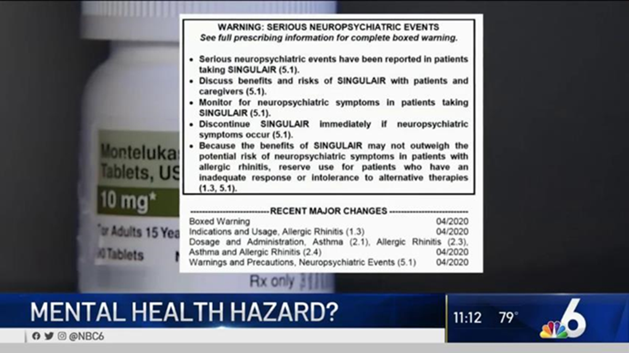
MOSAIC-NLP: Use of Natural Language Processing in a Pharmacoepidemiology Study: The Examination of Neuropsychiatric Events and Incident Use of Montelukast Among Patients with Asthma
Study Design: Retrospective cohort study
Study Data: Linked claims-EHR structured and unstructured data (2015-2022)
Study Cohort: Patients with asthma newly initiating monotherapy with montelukast (exposure) or inhaled corticosteroids (comparator)
Study Outcomes: Neuropsychiatric events
Study cohort: 109,076 patients
Healthcare systems: 119
Clinical notes: 17+ million

Slide 7
Outcomes: Neuropsychiatric Events
FDA’s Boxed Warning
Agitation, including aggressive behavior or hostility
Attention problems
Bad or vivid dreams
Depression
Disorientation or confusion
Feeling anxious
Hallucinations
Irritability
Memory problems
Obsessive-compulsive symptoms
Restlessness
Sleepwalking
Stuttering
Suicidal thoughts and actions
Tremor or shakiness
Trouble sleeping
Uncontrolled muscle movements
Claims/EHR Structured Data
Unstructured Data
Hospitalization/ER
OR
Diagnosis AND/OR Treatment of
Depression
Self harm
Psychotic disorder
Mood disorder
Anxiety disorder
OCD
Manic or bipolar disorder
Personality disorder
Hyperactivity or aggressive behavior or harm
Aggressive behavior or hostility
Agitation
Attention problems
Bad or vivid dreams
Depression
Disorientation or confusion
Dream abnormalities
Feeling anxious
Hallucinations
Irritability
Memory problems
Obsessive-compulsive symptoms
Restlessness
Sleepwalking
Stuttering
Suicidal thoughts and actions
Tremor or shakiness
Trouble sleeping
Uncontrolled muscle movements
Diagnosis OR Treatment of Sleep Disorder
Insomnia
Hypersomnia
Circadian rhythm disorder
Parasomnia
Movement disorder
Other undefined sleep disorder

Slide 8
Overview of NLP Process
NLP Tasks:
Named Entity Recognition
Assertion Status Detection
Relation Extraction
Develop annotation guidelines
Annotators annotate data based on the annotation guidelines as ground truth
Annotators resolve differences in annotations
Annotators consults with Subject Matter Experts on ambiguous cases
Annotated notes are exported for model training
80% notes to train models 20% notes to test models
Fine tune models and annotate more data if needed
Update models and training data
Annotate, Review, Fix
Train models
Agree on
54 Entities
7 Modifiers (intermittent, mild, moderate, severe, alleviated, worsened, other modifier)
8 Assertions (present, absent, past, possible, planned, hypothetical, family history, someone else)
Relations between entities and assertions/modifiers

Slide 9
NLP Model Results
Entity | True Positives | False Positives | False Negatives | Precision (Positive Predictive Value) | Recall (Sensitivity) | F1*
Self-harm | 950 | 34 | 37 | 0.965 | 0.963 | 0.964
ADHD | 135 | 6 | 7 | 0.957 | 0.951 | 0.954
Suicide Attempt | 89 | 9 | 10 | 0.908 | 0.899 | 0.904
Aggressive / Hostility | 229 | 33 | 43 | 0.874 | 0.842 | 0.858
Agitation | 58 | 12 | 11 | 0.829 | 0.841 | 0.835
Suicidal Ideation | 61 | 4 | 25 | 0.938 | 0.709 | 0.808
Attention Problems | 53 | 5 | 22 | 0.914 | 0.707 | 0.797
Completed Suicide | 0 | 0 | 9 | -- | 0 | 0
Stuttering | 0 | 0 | 2 | -- | 0 | 0
Decision to remove
Rare event/difficult to identify in model
Since for HIPAA conformance this cannot be used for patient, the added value is low for family history or ‘someone else’
Decision to remove
Rare event/difficult to identify in model
High cost time/effort
*F1 is the harmonic mean of precision (PPV) and recall (sensitivity), with possible scores from 0 to 1; higher scores indicate a better balance between precision and recall

Slide 10
Extracted Data to a Full Study-Ready Dataset
Data from Clinical notes extracted using NLP models
?
Additional study data

Slide 11
Sculpting from Marble – Unstructured Data Management
Things to consider:
Confidence score cutoffs
Current variables and what is going to be added and how
Unstructured data sources (e.g., types of entities, types of assertions, types of modifiers)
Scope and scale
Temporality
Input from healthcare providers

Slide 12
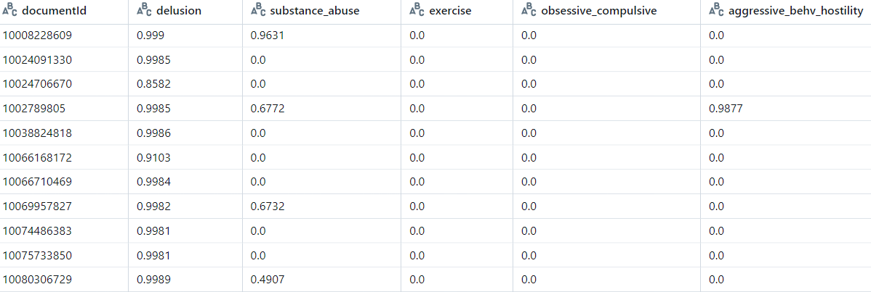
Confidence Score Cutoffs
Note: Confidence scores of >0.5 used as cutoff

Slide 13
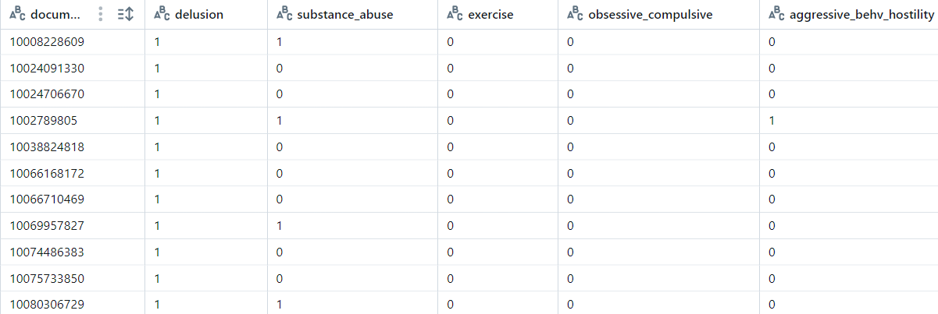
Confidence Score Cutoffs
0
Consider implications of using a different cutoff score for identifying binary data

Slide 14
Current Variables: What is going to be added and how
 | Assertions
 | Variable | Description Absent | Description Present | Description Possible | Description family history | Description Past
Modifiers | anxiety | current anxiety absent | present anxiety | possible anxiety | family history of current anxiety | past anxiety
 | anxiety-worsened | worsened anxiety absent | present worsened anxiety | possible worsened anxiety | family history of worsened anxiety | past worsened anxiety
 | anxiety-mild | mild anxiety absent | present mild anxiety | possible mild anxiety | family history of mild anxiety | past mild anxiety
 | anxiety-moderate | moderate anxiety absent | present moderate anxiety | possible moderate anxiety | family history of moderate anxiety | past moderate anxiety
 | anxiety-severe | severe anxiety absent | present severe anxiety | possible severe anxiety | family history of severe anxiety | past severe anxiety
 | anxiety-alleviated | alleviated anxiety absent | present alleviated anxiety | possible alleviated anxiety | family history of alleviated anxiety | past alleviated anxiety
 | anxiety-other_modifier | other modifier anxiety absent | present other modifier anxiety | possible other modifier anxiety | family history of other modifier anxiety | past other modifier anxiety
 | anxiety-intermittent | intermittent anxiety absent | present intermittent anxiety | possible intermittent anxiety | family history of intermittent anxiety | past intermittent anxiety
Include anxiety from structured data as:
Covariate (pre-index)
Outcome (post-index)
How to distill all this extracted NLP data into pre-index data and post-index data?
How to add to structured data variables?

Slide 15
Example: Anxiety
Extraction rules:
Present: No assertion label has to be added, entities are considered to have the present assertion by default if they do not have other assertion label.
Past: Found in phrases in past tense or that include words such as past, before, remote, previously, former, etc.
Absent: Found in phrases that include words such as no, without, lack, etc.
Family history: Only consanguinity relations are to be asserted as family history.
STUDY START
COVARIATE
INDEX
PATIENT A
OUTCOME
STUDY END
Present Anxiety
Anxiety Absent
Past Anxiety
Family Hx Anxiety
Present Anxiety
Past Anxiety
Family Hx Anxiety
Past Anxiety
Family Hx Anxiety
Present Anxiety
Past Anxiety
Family Hx Anxiety
Anxiety Absent
Past Anxiety
Family Hx Anxiety

Slide 16
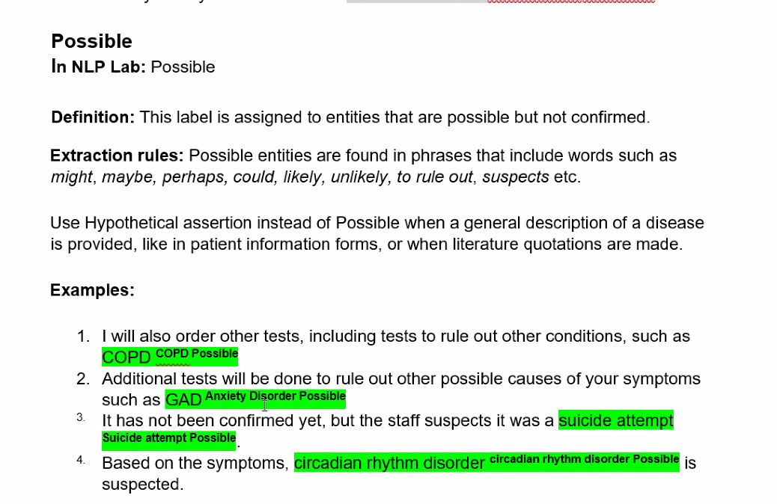
Example: Possible
STUDY START
COVARIATE
INDEX
PATIENT A
OUTCOME
STUDY END
Present Anxiety
Anxiety Absent
Past Anxiety
Family Hx Anxiety
Possible Anxiety
Past Anxiety
Family Hx Anxiety
Past Anxiety
Family Hx Anxiety
Present Anxiety
Past Anxiety
Family Hx Anxiety
Anxiety Absent
Past Anxiety
Family Hx Anxiety

Slide 17
Example: Anxiety Measured From Different Data Sources
Pre-index (unmatched covariates) – Anxiety 6-months prior to index (n = 25,413)
Post-index (unmatched outcomes) – Anxiety post index (n = 46,943)

Slide 18
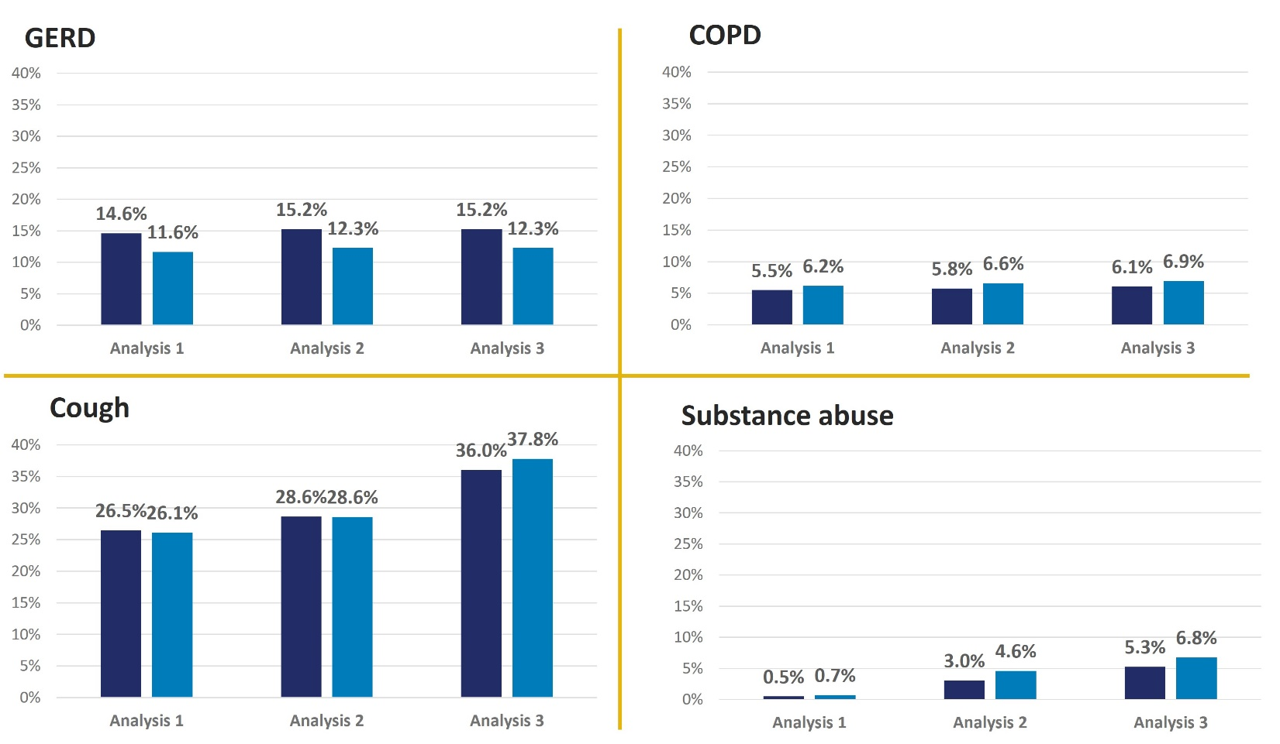
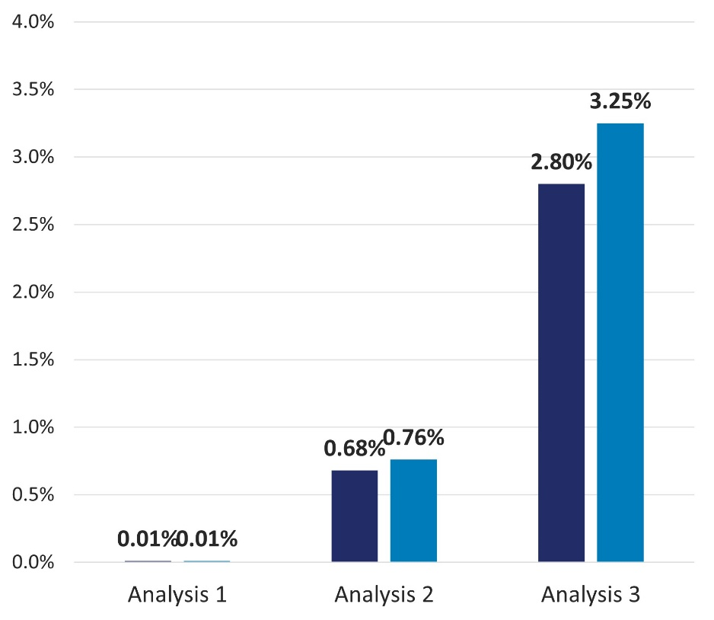
Covariates: Added Value of Structured and Unstructured EHR (6m prior to index)
Suicide Ideation/Attempt/Self-Harm
Montelukast
N=39,665
Inhaled Corticosteroids
N=69,411
Study 1 = claims only data; Study 2 = claims + EHR structured data; Study 3 = claims + EHR structured data + EHR unstructured data

Slide 19
Final Study Results
Coming soon…

Slide 20
Summary
Benefits of NLP
Improves identification or extraction of multiple data elements needed for drug safety assessments (exposures, outcomes, covariates)
Increases efficiency: speed (time saving), scale (can process a larger volume of unstructured data for the same manual effort)
Automated approach reduces potential for manual error or disagreement
Considerations for using NLP in pharmacoepidemiology studies
NLP algorithm accuracy is dependent on multiple factors: source data system, selection of notes for training
Users need to understand how study results may be impacted by the performance of NLP algorithms and how NLP-extracted data are operationalized for the study
Requires a team with a variety of expertise
Applying NLP to semi- and unstructured EHR data can capture valuable clinical and patient information that enriches structured data available via claims data, thus enhancing our abilities to assess medical product safety.

Slide 21
Questions?

